Slide 1
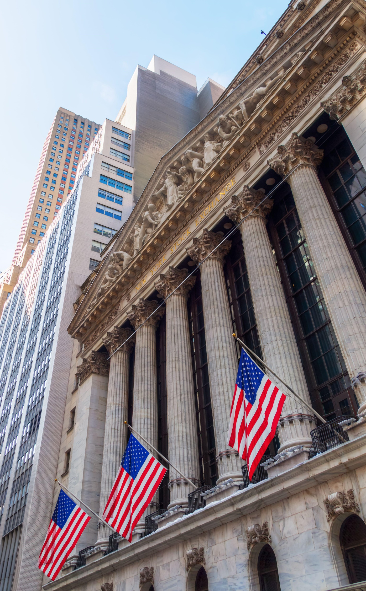
History lessons
Building better outcomes
Presenter’s Name
Presenter’s Title
<Date>
The performance data contained in this presentation represents past performance, which does not guarantee future results. Performance, especially for short time periods, should not be the sole factor in making your investment decisions. May lose value. No bank guarantee. Not FDIC insured. Not insured by any government agency.
Notes:
Welcome to History lessons. My name is ___ and I’m a ___ at John Hancock Investment Management.
I am delighted to be here to look at important lessons from history that every investor can benefit from understanding.
We are simply going to take a walk down memory lane to see where we have been and also take a peek around the corner to see where we may be going.

Slide 2
Today’s agenda
1
What does the history of market returns tell us?
2
Is diversification dead?
3
Is there a wrong time or a right time to invest?
4
What do inflation and rising rates mean?
5
What do I do now?
Notes:
In terms of our agenda, we are going to frame todays “history lessons” around 5 key questions:
What does the history of market returns tell us?
Is diversification dead?
Is there a wrong time or a right time to invest?
What do inflation and rising rates mean?
And finally, what do I do now?
As always, we will leave you with some key action steps and takeaways..

Slide 3
What does the history of market returns tell us?
Notes:
Let’s dig into our first “History lesson” – what does the history of market returns tell us?

Slide 4
Average market returns
Average annual returns from 1928–2023 (%)
Small company stocks | 11.86
Large company stocks | 9.85
Corporate bonds | 6.57
U.S. government bonds | 5.08
Inflation, as measured by the CPI | 3.04
Mid company stocks* | 12.79
*Average annual returns from 1979–2023 (%)
Source: Morningstar Direct. All rights reserved. Used with permission. Small company stocks are represented by IA SBBI US Small Stock Index which tracks the performance of a broad cross-section of U.S. small companies on a market-cap weighted basis. Mid Cap stocks are represented by Russell Mid Cap Index, which tracks the performance of approximately 800 publicly traded mid-cap companies in the United States. Large-company stocks are represented by the S&P 500 Index which tracks the performance of 500 of the largest publicly traded companies in the United States. Corporate bonds are represented by the IA Bloomberg US HY Corporate Bonds Index which tracks the performance of USD-denominated, non-investment grade, fixed-rate, taxable corporate bonds. U.S. government bonds are represented by the IA SBBI US LT Government Bond Index, which tracks the performance of U.S. Treasury bond with a maturity term of around 21.5 years. Inflation is measured by the Consumer Price Index, published by the U.S. Bureau of Labor Statistics. It is not possible to invest directly in an index. Past performance is no guarantee of future results.
Notes:
Let’s start by looking at the type of numbers you’ve likely seen before:
Average annual returns for certain asset classes compared to inflation from 1928-2023 were:
Small company stocks 11.86%
Large company stocks 9.85%
Corporate bonds 6.57%
U.S. government bonds 5.08%
Inflation, as measured by the CPI 3.04%
Now, for mid company stocks, we only have data going back to 1979. But as you can see, the average annual return since 1979 for mid caps has been 12.79%.
Now, you may look at these numbers and say great! If I had invested in any of these asset classes or combination of these asset classes during that time I would have done well – even after factoring in inflation. But what these numbers do not tell you is what that journey would have looked like.
To understand what I mean, let’s go back even further and look at the performance of the stock market…

Slide 5
In any given year, returns may be negative
Distribution of annual returns, S&P 500 Index, 1928–2023
 |  |  |  |  |  | 21
 |  |  |  |  |  | 2020
 |  |  |  |  |  | 2016
 |  |  |  |  |  | 2014
 |  |  |  |  |  | 2012 | 17
 |  |  |  |  |  | 2010 | 2023
 |  |  |  |  |  | 2006 | 2021
 |  |  |  | 14 | 14 | 2004 | 2017
 |  |  |  | 2018 | 2015 | 1993 | 2009 | 13
 |  |  |  | 2000 | 2011 | 1988 | 2003 | 2019
 |  |  |  | 1990 | 2007 | 1986 | 1999 | 2013
 |  |  |  | 1981 | 2005 | 1979 | 1998 | 1997
 |  |  |  | 1977 | 1994 | 1972 | 1996 | 1995
 |  |  |  | 1969 | 1992 | 1971 | 1983 | 1991
 |  |  |  | 1966 | 1987 | 1968 | 1982 | 1989
 |  |  | 6 | 1962 | 1984 | 1965 | 1976 | 1985
 |  |  | 2022 | 1953 | 1978 | 1964 | 1967 | 1980
 |  |  | 2001 | 1946 | 1970 | 1959 | 1963 | 1975 | 4
 |  | 3 | 1973 | 1939 | 1960 | 1952 | 1961 | 1955 | 1958
 | 2 | 2002 | 1957 | 1934 | 1956 | 1949 | 1951 | 1950 | 1935
1 | 2008 | 1974 | 1941 | 1932 | 1948 | 1944 | 1943 | 1945 | 1933 | 1
1931 | 1937 | 1930 | 1940 | 1929 | 1947 | 1942 | 1938 | 1936 | 1928 | 1954
-50% to -40% | -40% to -30% | -30% to -20% | -20% to -10% | -10% to 0% | 0% to 10% | 10% to 20% | 20% to 30% | 30% to 40% | 40% to 50% | 50% to 60%
Number of occurrences
■ Positive years 70 (73%)
■ Negative years 26 (27%)
Source: Bloomberg, 2023. The S&P 500 Index tracks the performance of 500 of the largest publicly traded companies in the United States. It is not possible to invest directly in an index. Past performance does not guarantee future results.
Notes:
Stock growth doesn’t occur in a straight line. In any given year, the stock market’s returns may be negative.
The chart shows the distribution of the stock market’s annual returns since 1928. As you can see, stocks gained ground 73% of the time.
Of course, the stock market fell the other 27% of the time — and some of those losses were large. Weathering those kinds of short-term losses is part of long-term investing.

Slide 6
The longer you hold stocks, the better the chance returns will be positive
Rolling 10-year stock market returns, 1928–2023
Number of occurrences
■ Positive years 82 (94%)
■ Negative years 5 (6%)
 |  |  |  | 14 |  |  | 14 |  | 14
 |  |  |  | 2016 | 13 |  | 2023 |  | 2021
 |  |  |  | 2015 | 2017 |  | 2022 |  | 2000
 |  |  |  | 2014 | 2006 |  | 2020 |  | 1992
 |  |  |  | 2013 | 2005 |  | 2019 |  | 1991
 |  |  |  | 2012 | 2002 |  | 2018 |  | 1989
 |  |  |  | 1982 | 1980 |  | 2004 |  | 1988
 |  |  |  | 1981 | 1972 |  | 2001 | 7 | 1963
 |  |  |  | 1976 | 1970 |  | 1990 | 1996 | 1961 | 6
5 |  | 5 |  | 1973 | 1968 |  | 1986 | 1995 | 1960 | 1999
2009 |  | 2011 |  | 1971 | 1966 |  | 1967 | 1994 | 1957 | 1998
2008 | 3 | 1978 | 3 | 1969 | 1949 | 3 | 1964 | 1993 | 1955 | 1997
1939 | 2010 | 1977 | 2007 | 1948 | 1947 | 2003 | 1962 | 1987 | 1954 | 1959
1938 | 1974 | 1975 | 1979 | 1945 | 1944 | 1983 | 1953 | 1985 | 1952 | 1958
1937 | 1940 | 1946 | 1941 | 1943 | 1942 | 1965 | 1950 | 1984 | 1951 | 1956
<0% | 0% to 2% | 2% to 4% | 4% to 6% | 6% to 8% | 8% to 10% | 10% to 12% | 12% to 14% | 14% to 16% | 16% to 18% | >18%
Source: The data is calculated by John Hancock Investment Management using information presented in Bloomberg, 2023. All rights reserved. Used with permission. Stocks are represented by the S&P 500 Index, which tracks the performance of 500 of the largest publicly traded companies in the United States. It is not possible to invest directly in an index. Past performance does not guarantee future results. Data begins in 1928 with the first 10-year period in 1937.
Notes:
However, it can be bit easier to “weather” those declining years once you understand that the longer you hold equities, the better the chance the returns will be positive. This chart represents rolling 10 year periods from 1937 to 2023. (NOTE TO SPEAKER: This chart actually does go back to 1928 because the first rolling 10-year period is from 1928-1937)
Once again, negative periods are in blue, positive periods are in green
There have been 87 ten-year rolling periods over the same period: from 1928 through 1937, 1929 through 1938, and so on. The market lost ground in only five of those 87 ten-year periods.
In other words, someone who held stocks for just 1 year had roughly a 27% chance of losing money. Someone who held stocks for 10 years had only a 6% chance of losing money.

Slide 7
Great years are not that uncommon
Performance of stocks since 1928
Total number of years since 1928 when the stock market has had an annual return of over 20%
Calendar year returns of 8% to 12% have occurred
ONLY 4 TIMES IN 96 YEARS.
Source: Bloomberg, as of 12/31/2023. Data is based on S&P 500 Index price annual returns including dividends. The S&P 500 Index tracks the performance of 500 of the largest publicly traded companies in the United States. It is not possible to invest directly in an index. Past performance does not guarantee future results.
Notes:
Now that we understand that some years will be negative but that positive years outweigh negative years, the next point we want to make is that great years in the market are NOT uncommon!
Interestingly, it’s less likely for the market to post an average return in a given year—in fact, calendar year returns of between 0% and 10% have occurred only 14 times in the last 96 years. However, calendar year returns over 20% have occurred 35 times in the last 96 years. So don’t expect the average, expect the extremes.
The fact is, the market has been more likely to gain 20% or more than to lose money in a given calendar year.

Slide 8
There is nothing average about returns
1928–2023
What’s the most common occurrence in the stock market in a calendar year?
# of occurrences / % of occurrences
36.5%
36.5%
27.1%
Calendar year returns of 8–12% have occurred ONLY 4 TIMES IN THE 96 YEARS SINCE 1928
Source: Calculated by John Hancock Funds, LLC using information and data presented in Morningstar Direct. All rights reserved. Used with permission. Based on average annual percentage returns for the S&P 500 Index over 95 one-year periods from 1928-2023, assuming reinvestment of dividends and capital gains. The S&P 500 Index tracks the performance of 500 of the largest publicly traded companies in the United States. It is not possible to invest directly in an index. Past performance is no guarantee of future results.
Notes:
To further demonstrate that the stock market is a market of extremes, consider this chart:
It divides calendar year returns from 1928 through 2023 into three broad buckets. The years that the market declined are on the left.
The years that the market experienced returns between 0% to 20% are in the middle.
The years that the market’s total return exceeded 20% are on the right.
Which of these three buckets would you say contains the largest number of calendar years?
(Take a minute for responses.)
For many, the logical assumption is that the middle bucket, with returns between 0% to 20%, holds the greatest number of occurrences … but, look closer.
Down years for the market occurred 26 times or 27.1% of the time from 1928 through 2023.
The market posted returns of 0% to 20% only 35 years, or 36.5% of the time.
The most common occurrences were years when the market was up more than 20%. This occurred 35 times, or 36.5% of the time.
If you normally expect an average annual return of 8% to 12%, it has only happened four times in the 96 years since 1928!

Slide 9
It is a market of extremes
S&P 500 Index calendar year returns, 1928–2023 (%)
The average annual return from 1928 to 2023 is 9.8%
Source: Calculated by John Hancock Funds, LLC using information and data presented in Morningstar Direct. All rights reserved. Used with permission. Based on average annual percentage returns for the S&P 500 Index over 94 one-year periods from 1928-2023, assuming reinvestment of dividends and capital gains. The S&P 500 Index tracks the performance of 500 of the largest publicly traded companies in the United States. It is not possible to invest directly in an index. Past performance is no guarantee of future results.
Notes:
Here is another way to look at this market of extremes… This chart shows every calendar year return from 1928 through 2023.
What stands out for you in this chart?
(Take a minute for responses.)
What stands out for me is the yellow line, which represents the long-term historical average return.
As you see, there are very few years where the market finished in or around the yellow line.
Far more often, market returns were either significantly higher or significantly lower.
Moderate or average returns are simply not the norm.
This is why I believe that what you should expect is what the market has historically been—a market of extremes.

Slide 10
What does the history of market returns tell us?
Historically, since 1928 the average return for the S&P 500 has been 9.8%
However, the stock market is a market of extremes and returns of 10% are not the norm.
Investors should expect highs and lows in the short term.
Remember you investment time horizon and invest for the long term.
Source: Calculated by John Hancock Funds, LLC using information and data presented in Morningstar Direct. All rights reserved. Used with permission. Based on average annual percentage returns for the S&P 500 Index over 94 one-year periods from 1928-2023, assuming reinvestment of dividends and capital gains. The S&P 500 Index tracks the performance of 500 of the largest publicly traded companies in the United States. It is not possible to invest directly in an index. Past performance is no guarantee of future results.
Notes:
So, in the end, “What does the history of market returns tell us?”
Clearly, the stock market is a market of extremes, and returns of 10% are not the norm. Historically, since 1928, the average annual return for the S&P 500 Index has been 9.8%. A logical assumption can be that most years were close to that average. However, as you have seen, getting close to that average is relatively rare.
You should expect highs and lows in the short-term, but, remember to keep in mind your investment time horizon.

Slide 11
Is diversification dead?
Notes:
Now for our second “history lesson” - Is diversification dead? Let’s explore the data…

Slide 12
Sometimes, traditional asset allocation didn’t work
2005
2008
2011
 | Value | Blend | Growth
 | 6.0 | 5.9 | 6.7
 | 8.8 | 9.3 | 9.8
 | 6.4 | 6.8 | 6.0
 | Value | Blend | Growth
 | -37.1 | -37.8 | -40.7
 | -36.8 | -39.2 | -43.8
 | -32.2 | -36.6 | -41.6
 | Value | Blend | Growth
 | -0.8 | -1.3 | -2.5
 | -4.0 | -3.8 | -4.0
 | -4.5 | -4.1 | -3.6
Large
Large
Large
Mid
Mid
Mid
Small
Small
Small
Range
3.8%
11.6%
3.7%
2012
2018
 | Value | Blend | Growth
 | 14.6 | 15.0 | 15.3
 | 16.6 | 16.2 | 14.1
 | 16.0 | 15.5 | 13.2
 | Value | Blend | Growth
 | -8.5 | -6.3 | -2.1
 | -12.9 | -11.2 | -6.7
 | -15.5 | -12.7 | -5.8
Large
Large
Mid
Mid
Small
Small
Range
3.4%
13.4%
Source: Bloomberg, as of 12/31/2023. Large growth is represented by the Russell 1000 Growth Index, mid value is represented by the Russell Mid Cap Value Index, mid growth is represented by the Russell Mid Cap Growth Index, small value is represented by the Russell 2000 Value Index, and small growth is represented by the Russell 2000 Growth Index. The Russell 1000 Growth Index tracks the performance of publicly traded large-cap companies in the United States with higher price-to-book ratios and higher forecasted growth values. The Russell Midcap Growth Index tracks the performance of publicly traded mid-cap companies with higher price-to-book ratios and higher forecasted growth values. The Russell Midcap Value Index tracks the performance of publicly traded mid-cap companies with lower price-to-book ratios and lower forecasted growth values. The Russell 2000 Index tracks the performance of approximately 2,000 publicly traded small-cap companies in the United States. It is not possible to invest directly in an index.It is not possible to invest directly in an index. Past performance does not guarantee future results. Diversification does not guarantee a profit or eliminate the risk of a loss. For more information on the Morningstar Style Box™, please see the "A word about risk" section.
Notes:
Hey Folks – Look, I am sure some of you are reading the same articles, that I am reading in some of the more prominent magazines and journals. The headlines read – RUN, diversification is dead, dormant and inactive. Well, as you and I know, that is simply erroneous and misleading. Of course, there may be brief intervals, in which diversification appears to be broken, but over time, there is empirical evidence that diversification works. First, let’s take a peek at some of those years in which diversification was not in vogue.
As you can see, you really weren’t rewarded or punished for sitting a particular space in the Morningstar style box in several years, including, 2005, 2011 & 2012. The divergence between the best and worst performing asset classes in those years is uncommonly tight – in the 3 percent range. Even worse, in 2011, all the asset classes were negative!
Also years like 2008, and 2018 stand out. Almost every type of investment was in the red for the year.
The first thing that happens a result of this is that you may start wondering why you should own investments in different asset classes when all suffered declines. Well, the divergence between the best and worst performing asset classes in 2008 and 2018 was 11.6% and 13.4%. In those years, diversification could have lessened the blow of poor returns.
Remember, diversification is intended to capitalize on the fact that, in a given time period, different types of investments tend to generate different returns.

Slide 13
Other times, it did
2003
2007
2009
2016
 | Value | Blend | Growth
 | 28.4 | 27.1 | 28.7
 | 33.9 | 36.3 | 36.0
 | 42.4 | 43.4 | 45.5
 | Value | Blend | Growth
 | 1.4 | 6.6 | 13.4
 | 0.8 | 4.8 | 15.1
 | -6.1 | -1.1 | 7.6
 | Value | Blend | Growth
 | 24.1 | 28.2 | 35.7
 | 35.4 | 37.4 | 39.1
 | 31.3 | 31.8 | 35.5
 | Value | Blend | Growth
 | 14.8 | 10.4 | 3.2
 | 18.1 | 14.1 | 6.0
 | 26.0 | 20.8 | 11.2
Large
Large
Large
Large
Mid
Mid
Mid
Mid
Small
Small
Small
Small
Range
18.4%
21.2%
15.0%
22.8%
2017
2020
2021
2022
2023
 | Value | Blend | Growth
 | 15.9 | 20.4 | 27.7
 | 13.2 | 15.9 | 23.9
 | 8.5 | 12.3 | 21.5
 | Value | Blend | Growth
 | 2.9 | 15.8 | 35.9
 | 2.6 | 12.4 | 39.3
 | 4.0 | 11.0 | 38.6
 | Value | Blend | Growth
 | 26.2 | 26.1 | 20.4
 | 29.3 | 23.4 | 13.1
 | 31.6 | 24.2 | 11.9
 | Value | Blend | Growth
 | -7.54 | -17.0 | -29.14
 | -12.03 | -14.0 | -26.72
 | -14.48 | -16.2 | -26.36
 | Value | Blend | Growth
 | 11.78 | 22.14 | 35.98
 | 13.72 | 15.91 | 21.22
 | 16.61 | 16.02 | 16.48
Large
Large
Large
Large
Large
Mid
Mid
Mid
Mid
Mid
Small
Small
Small
Small
Small
Range
19.2%
36.7%
19.7%
18.8%
24.2%
Source: Morningstar, as of 12/31/2023. Large value is represented by the US Fund Large Value category average. Large blend is represented by US Fund Large blend category average. Large growth is represented by US Large Growth category average. Mid value is represented by the US Fund Mid-Cap Value category average. Mid blend is represented by US Fund Mid-Cap Blend category average. Mid growth is represented by US Fund Mid-Cap Growth category average . Small value is represented by US Fund Small Value category average. Small blend is represented by US Fund Small Blend category average. Small growth is represented by US Fund Small Growth category average. It is not possible to invest directly in an index. Past performance does not guarantee future results. Diversification does not guarantee a profit or eliminate the risk of a loss. For more information on the Morningstar Style Box™, please see the "A word about risk" section.
Notes:
While diversification doesn't work EVERY SINGLE YEAR, over time, it can help you reach your goals. Yet another reason why your time horizon is a critical consideration when investing in equities...
OK, so now, let’s get to the good stuff. As you can see, Diversification is the cool kid in the school again. Specifically, take a look at some recent strong years in the market – 2020, 2021, and 2023…could you have simply closed your eyes and tossed some dough at the Morningstar style boxes and be equally rewarded? Absolutely not – in fact, the gap between the best performing and the worst performing asset class in 2020 was over 36.7% and in 2021 it was 19.7% and in 2023 it was 24.2%.
In fact, all of these years are pretty dramatic examples. Diversification is never dead, it may take naps periodically, but over time it is alive and kicking!

Slide 14
A diversified bond portfolio can help reduce volatility
Bond market performance is constantly changing along with interest rates and the economic outlook (%)
10-year U.S Treasury yield
Effective federal funds rate
2003 | 2004 | 2005 | 2006 | 2007 | 2008 | 2009 | 2010 | 2011 | 2012 | 2013 | 2014 | 2015 | 2016 | 2017 | 2018 | 2019 | 2020 | 2021 | 2022 | 2023
High yield 28.15% | Foreign bonds 12.14% | Emerging- market debt 10.25% | High yield 11.72% | Foreign bonds 11.45% | 10-year U.S. Treasuries 20.06% | High yield 57.51% | High yield 15.91% | 10-year U.S. Treasuries 17.14% | Emerging- market debt 17.44% | High yield 7.42% | 10-year U.S. Treasuries 10.72% | Mortgage backed 1.51% | High yield 17.49% | Foreign bonds 10.33% | Cash 1.86% | Emerging-market debt 15.04% | Foreign bonds 10.78% | Floating rate 5.40% | Cash 1.50% | High yield 13.46%
Emerging- market debt 22.21% | Emerging- market debt 11.62% | Floating rate 5.69% | Emerging- market debt 9.86% | 10-year U.S. Treasuries 9.79% | Foreign bonds 10.11% | Floating rate 44.87% | Emerging- market debt 12.24% | IG corporates 8.15% | High yield 15.59% | Floating rate 6.15% | IG corporates 7.46% | Emerging- market debt 1.18% | Emerging- market debt 10.15% | Emerging- market debt 10.26% | Floating rate 1.14% | IG corporates 14.54% | 10-year US Treasuries 10.58% | High yield 5.36% | Floating rate -1.06% | Floating rate 13.04%
Foreign bonds 18.52% | High yield 10.87% | Cash 3.00% | Floating rate 7.33% | Mortgage backed 6.96% | Mortgage backed 8.52% | Emerging- market debt 29.82% | Floating rate 9.98% | Emerging- market debt 7.35% | IG corporates 9.82% | Short-term credit 1.24% | Emerging- market debt 7.43% | Short-term credit 1.06% | Floating rate 9.88% | High yield 7.47% | Short-term credit 1.11% | High yield 14.41% | IG corporates 9.89% | Cash 0.05% | Short-term credit -5.56% | Emerging- market debt 11.09%
Floating rate 11.01% | Diversified bonds 6.58% | High yield 2.74% | Foreign bonds 6.94% | Emerging- market debt 6.16% | Cash 1.80% | IG corporates 18.68% | IG corporates 9.00% | Mortgage backed 6.32% | Floating rate 9.43% | Cash 0.05% | Mortgage backed 6.15% | 10-year U.S. Treasuries 0.91% | IG corporates 6.11% | IG corporates 6.42% | Mortgage backed 0.99% | Diversified bonds 9.02% | Diversified bonds 6.58% | Short-term credit -0.55 | Diversified bonds -11.21% | IG corporates 8.52%
Diversified bonds 10.75% | Floating rate 5.60% | Mortgage backed 2.61% | Diversified bonds 6.25% | Short-term credit 6.09% | Short-term credit –1.13% | Diversified bonds 17.21% | Diversified bonds 7.91% | Diversified bonds 6.00% | Diversified bonds 7.27% | Diversified bonds –0.69% | Diversified bonds 3.93% | Cash 0.03% | Diversified bonds 5.53% | Diversified bonds 5.53% | 10-year U.S. Treasuries -0.03% | 10-year U.S. Treasuries 8.91% | High yield 6.17% | Diversified bonds -0.80% | High yield -11.22% | Diversified bonds 7.93%
IG corporates 8.24% | IG corporates 5.39% | Diversified bonds 2.17% | Mortgage backed 5.22% | Diversified bonds 6.00% | Diversified bonds –4.04% | Short-term credit 13.52% | 10-year U.S. Treasuries 7.90% | Foreign bonds 5.17% | Short-term credit 5.51% | Mortgage backed –1.45% | High yield 2.50% | Floating rate –0.38% | Short-term credit 2.58% | Floating rate 4.25% | Diversified bonds -0.58% | Floating rate 8.17% | Emerging-market debt 5.26% | IG corporates -1.04% | Mortgage backed -11.81% | Short-term credit 5.94%
Short-term credit 5.40% | 10-year U.S. Treasuries 4.83% | 10-year U.S. Treasuries 1.99% | Cash 4.76% | Cash 4.74% | IG corporates –4.94% | Mortgage backed 5.75% | Mortgage backed 5.50% | High yield 4.38% | 10-year U.S. Treasuries 4.18% | IG corporates –1.53% | Floating rate 2.06% | IG corporates –0.68% | Foreign bonds 1.81% | Mortgage backed 2.47% | Foreign bonds -1.82% | Short-term credit 6.58% | Short-term credit 5.19% | Mortgage backed -1.04% | IG corporates -15.76% | Foreign bonds 5.83%
Mortgage backed 3.07% | Mortgage backed 4.70% | IG corporates 1.68% | Short-term credit 4.69% | IG corporates 4.56% | Emerging- market debt –12.03% | Foreign bonds 4.39% | Short-term credit 5.44% | Short-term credit 3.04% | Mortgage backed 2.60% | Foreign bonds –4.56% | Short-term credit 1.95% | Diversified bonds –0.70% | Mortgage backed 1.67% | Short-term credit 2.32% | High yield -2.26% | Mortgage backed 6.35% | Mortgage backed 3.87% | Emerging-market debt -1.80% | 10-year U.S. Treasuries -16.28% | Cash 5.26%
10-year U.S. Treasuries 1.32% | Short-term credit 2.44% | Short-term credit 1.35% | IG corporates 4.30% | High yield 2.24% | High yield –26.39% | Cash 0.16% | Foreign bonds 5.21% | Floating rate 1.82% | Foreign bonds 1.51% | Emerging- market debt –5.25% | Cash 0.03% | High yield –4.64% | Cash 0.27% | 10-year U.S. Treasuries 2.07% | IG corporates -2.51% | Foreign bonds 5.32% | Floating rate 2.78% | 10-year US Treasuries -3.68% | Emerging-market debt -17.78% | Mortgage backed 5.05%
Cash 1.07% | Cash 1.24% | Foreign bonds –9.20% | 10-year U.S. Treasuries 1.34% | Floating rate 1.88% | Floating rate –28.75% | 10-year U.S. Treasuries –9.71% | Cash 0.13% | Cash 0.08% | Cash 0.07% | 10-year U.S. Treasuries –7.83% | Foreign bonds –2.68% | Foreign bonds –5.54% | 10-year U.S. Treasuries –0.16% | Cash 0.84% | Emerging-market debt -4.26% | Cash 2.25% | Cash 0.58% | Foreign bonds -9.68 | Foreign bonds -22.07% | 10-year U.S. Treasuries 2.83%
BEST PERFORMER
WORST PERFORMER
Source: Morningstar Direct, as of 12/31/23. This chart does not illustrate the performance of any John Hancock fund. Emerging-market debt (EMD) is measured by the J.P. Morgan EM Bond Index (EMBI) Global Diversified Index, which tracks the performance of U.S. dollar-denominated Brady bonds, Eurobonds, and traded loans issued by sovereign and quasisovereign entities, capping exposure to countries with larger amounts of outstanding debt. High yield is measured by the Intercontinental Exchange (ICE) Bank of America (BofA) U.S. High Yield Index, which tracks the performance of below-investment-grade U.S. dollar-denominated corporate bonds publicly issued in the U.S. domestic market and includes issues with a credit rating of BBB or below. Mortgage-backed securities (MBS) are measured by the Bloomberg U.S. MBS Index, which tracks 15- and 30-year fixed-rate securities backed by the mortgage pools of Ginnie Mae, Freddie Mac, and Fannie Mae. Floating rate is measured by the Credit Suisse (CS) Leveraged Loan Index, which tracks the U.S. dollar-denominated, noninvestment-grade leveraged loan market. Short-term credit is measured by Bloomberg 1–5 Year U.S. Credit Index, which tracks the performance of investment-grade U.S. corporate and government-related bonds with maturities between one and five years. Cash is represented by the FTSE 3-Month U.S. Treasury Bill Index, which tracks the performance of the most recent three-month U.S. Treasury bill issues. Foreign bonds are represented by the FTSE World Government Bond ex-U.S. Index, which measures the performance of fixed-rate, local currency, IG sovereign bonds, excluding the United States. IG corporate bonds (IG corporates) are measured by the Bloomberg U.S. Corporate Index, which tracks the IG, U.S. dollar-denominated, fixed-rate, taxable corporate bond market. 10-year U.S. Treasuries (10yr UST) are measured by the ICE BofA 10-Year U.S. Treasury Index, a one-security index, rebalanced monthly, comprising the most recently issued 10yr UST note. Diversified bonds reflect an equal-weighted blend of all nine categories shown in the chart, rebalanced quarterly. Performance figures assume reinvestment of dividends and capital gains. It is not possible to invest directly in an index. Past performance does not guarantee future results.
Notes:
Just like with equities, bond asset classes perform differently. Many bond portfolios traditionally have consisted of U.S. Treasuries and high-grade corporate bonds, but fluctuating interest rates, those categories alone aren’t likely to generate the returns you may need over the coming years.
Fortunately, there are many other fixed-income categories, from foreign bonds and emerging-market debt to floating-rate bank loans and high-yield bonds. So, the message is to look beyond the main-stream for opportunities. Holding exposure to a wide variety of fixed-income types can help you capture new opportunities.
We often get asked why Bonds have negative years. As you can see from the above Fed Funds rate, and 10yr, rising rates make it harder for existing bonds to perform well as they are less attractive than "newer, high-yielding bonds". But more importantly, this shows that "not all bonds, or bond funds, are created/treated equally". Some perform better in rising rates than others, and vice-versa
In any given year, it’s very difficult to project which types of bonds will perform best. As you can see, the best-performing category one year may be among the worst performers the next—consider that the best performing fixed income category in 2020 was foreign bonds but it was floating rate bonds in 2021, cash in 2022, and high yield in 2023.
Holding a broadly diversified bond portfolio can help you take advantage of the opportunities in the market while managing the risks associated with any one bond type.

Slide 15
Traditional asset classes may not offer much protection in a severe market sell-off
Nowhere to hide
Total returns by asset class, 2008 (%)
Source: Bloomberg, as of 2008. Emerging markets are represented by the MSCI Emerging Markets Index, which tracks the performance of publicly traded large- and mid-cap emerging-market stocks. International small cap is represented by the MSCI Europe, Australasia, and Far East (EAFE) Small Cap Index, which tracks the performance of publicly traded small-cap stocks of companies in those regions. Global real estate is represented by the Dow Jones Wilshire Global REIT Index, a measure of the types of global real estate securities that represent the ownership and operation of commercial or residential real estate. Natural resources are represented by the MSCI Natural Resources Index, which features equity securities of companies engaged in the natural resources industry. International stocks are represented by the MSCI EAFE Growth Index, which tracks the performance of publicly traded growth-oriented large- and mid-cap stocks of companies in those regions. U.S. real estate is represented by the FTSE NAREIT Equity REIT Index, an unmanaged index consisting of the most actively traded real estate investment trusts (REITs). U.S. stocks are represented by the S&P 500 Index, which tracks the performance of 500 of the largest publicly traded companies in the United States. Bank loans are represented by the Bloomberg Barclays High Yield Municipal Bond Index, which tracks the performance of municipal bonds rated below investment grade (BBB/Baa) and those that are unrated. High-yield bonds are represented by the Intercontinental Exchange (ICE) Bank of America (BofA) U.S. High Yield Master II Index, which tracks the performance of globally issued, U.S. dollar-denominated high-yield bonds. TIPS (Treasury Inflation-Protected Securities) are represented by the Barclays U.S. Treasury U.S. TIPS Index, an unmanaged index that comprises inflation-protected securities issued by the U.S. Treasury. U.S. bonds are represented by the Bloomberg Barclays U.S. Aggregate Bond Index, which tracks the performance of U.S. investment-grade bonds in government, asset-backed, and corporate debt markets. It is not possible to invest directly in an index. Diversification does not guarantee a profit or eliminate the risk of a loss. Past performance does not guarantee future results.
Notes:
Now, many people may say, “I held a diversified portfolio in 2008 and it didn’t help me! Well, you would be correct – if it was a portfolio of traditional asset classes. This chart shows the returns of a wide variety of traditional assets in 2008, when investors questioned the viability of the global financial system. As you can see, every major asset class except U.S. bonds posted large losses. Traditional diversification didn’t protect investors from the bear market in that case….

Slide 16
Nontraditional asset classes can play a role during difficult periods for equities
Average annual returns during the lost decade, 2000–2009
Source: Morningstar Direct, as of 12/31/2023. Performance numbers reflect a total return average of funds in each Morningstar category, as applicable; assume reinvestment of all distributions; and do not reflect payment of any sales charges. It is not possible to invest directly in an index. Past performance does not guarantee future results.
Notes:
What you may not know is that nontraditional asset classes can play a role during difficult stretches like that one. As you can see, assets such as real estate, natural resources, and emerging markets posted strong returns during the same period. Investors who had some exposure to those types of investments had a degree of protection from stocks’ “lost decade.”
Lost decade – Stocks posted strong returns over the vast majority of 10-year periods over the last century. There were a few exceptions however, including a recent one: The S&P 500 Index posted a 1% annualized loss during the 10 years through 2009.

Slide 17
Is your portfolio ready for the next stock market downturn?
Blended index (65% stocks/35% bonds)¹
S&P 500 Index
Growth of $500,000
1/1/00–12/31/23
Tech bubble bursts Cumulative returns 3/24/00–10/9/02
The lost decade Cumulative returns 1/1/00–12/31/09
Financial crisis Cumulative returns 10/10/07–3/9/09
Blended index
S&P 500 Index
-25.51%
-47.37%
Blended index
S&P 500 Index
24.40%
-9.10%
Blended index
S&P 500 Index
-36.82%
-55.25%
3,000,000
$2,562,980
$2,456,030
2,500,000
2,000,000
1,500,000
Since 2000
Average annual returns 1/1/00–12/31/23
1,000,000
Blended index
S&P 500 Index
6.37%
7.03%
500,000
0
1/00 12/03 12/05 12/07 12/09 12/11 12/13 12/15 12/17 12/19 12/21 12/23
1 The blended index comprises 65% S&P 500 Index and 35% Bloomberg U.S. Aggregate Bond Index. The S&P 500 Index tracks the performance of 500 of the largest companies in the United States. The Bloomberg U.S. Aggregate Bond Index tracks the performance of U.S. investment-grade bonds in government, asset-backed, and corporate debt markets. It is not possible to invest directly in an index.
The past performance shown here reflects reinvested distributions and the beneficial effect of any expense reductions, and does not guarantee future results. Performance for the diversified portfolio and the blended index reflects annual rebalancing. Diversification does not guarantee a profit or eliminate the risk of a loss.
Notes:
So what does all of this mean for diversification as we look forward? While we cannot project the future, history does have some insights for us.
As we have seen, economic outlooks are never certain, but even amid expectations for a return to growth, you may wonder how your portfolio will fare.
(Note to speaker - This also shows that "timing" isn't always super important. It's "time IN the market, not TIMING the market" that matters. You see, these two portfolios started with AWFUL timing, right before a 47% stock market drawdown/recession. Yet despite that, they went up five-fold during this tough 20+ year stretch. If that's what bad luck does to a portfolio, imagine if this 20+ year period was an average/good stretch for the market.)

Slide 18
The markets are unpredictable
Diversification helps ensure that you don’t own too many of the worst-performing asset classes
Annual returns of asset class categories
2013 | 2014 | 2015 | 2016 | 2017 | 2018 | 2019 | 2020 | 2021 | 2022 | 2023
U.S. small-cap equity 38.82% | U.S. large-cap equity 13.24% | U.S. large-cap equity 0.92% | U.S. small-cap equity 21.31% | International equity 27.77% | Cash 1.86% | U.S. large-cap equity 31.43% | U.S. large-cap equity 20.96% | U.S. large-cap equity 26.45% | Cash 1.50% | U.S. large-cap equity 26.53%
U.S. large-cap equity 33.11% | Investment- grade bonds 5.97% | Investment- grade bonds 0.55% | High-yield bonds 17.49% | U.S. large-cap equity 21.69% | Investment- grade bonds 0.01% | U.S. small-cap equity 25.52% | U.S. small-cap equity 19.96% | Alternatives 16.10% | High-yield bonds –1.22% | U.S. small-cap equity 16.93%
International equity 15.78% | U.S. small-cap equity 4.89% | Cash 0.03% | U.S. large-cap equity 12.05% | U.S. small-cap equity 14.65% | High-yield bonds -2.26% | International equity 22.13% | Diversified portfolio 11.71% | U.S. small-cap equity 14.82% | Alternatives –2.35% | International equity 16.21%
Diversified portfolio 15.55% | Diversified portfolio 4.23% | Diversified portfolio –2.79% | Diversified portfolio 10.78% | Diversified portfolio 13.360% | Alternatives -3.84% | Diversified portfolio 18.97% | International equity 11.13% | Diversified portfolio 11.42% | Investment- grade bonds –13.01% | Diversified portfolio 13.98%
High-yield bonds 7.42% | High-yield bonds 2.50% | Alternatives –3.92% | Alternatives 6.21% | High-yield bonds 7.48% | U.S. large-cap equity -4.78% | High-yield bonds 14.41% | Investment- grade bonds 7.51% | International equity 8.29% | Diversified portfolio –13.44% | High-yield bonds 13.46%
Alternatives 0.21% | Alternatives 2.19% | U.S. small-cap equity –4.41% | International equity 5.01% | Alternatives 5.05% | Diversified portfolio -5.77% | Alternatives 11.53% | High-yield bonds 6.17% | High-yield bonds 5.36% | International equity –15.57% | Investment- grade bonds 5.53%
Cash 0.05% | Cash 0.03% | High-yield bonds –4.64% | Investment- grade bonds 2.65% | Investment- grade bonds 3.54% | U.S. small-cap equity -11.01% | Investment- grade bonds 8.72% | Alternatives 1.06% | Cash 0.05% | U.S. large-cap equity –19.13% | Cash 5.26%
Investment- grade bonds –2.02% | International equity –3.44% | International equity –5.25% | Cash 0.27% | Cash 0.84% | International equity -13.78% | Cash 2.25% | Cash 0.58% | Investment- grade bonds –1.54% | U.S. small-cap equity –20.44% | Alternatives 4.74%
Stay diversified
Those who stayed invested in a diversified portfolio throughout the last decade fared well, despite volatility along the way.
BEST PERFORMER
Growth of $10,000 for diversified portfolios
$10K
$17.5K
WORST PERFORMER
Source: John Hancock Investment Management, as of 12/31/2023.
Source: Morningstar, as of 12/31/2023. Investment-grade bonds are represented by the Bloomberg Barclays U.S. Aggregate Bond Index, which tracks the performance of U.S. investment-grade bonds in government, asset-backed, and corporate debt markets. High-yield bonds are represented by the Intercontinental Exchange (ICE) Bank of America (BofA) U.S. High Yield Master II Index, which tracks the performance of globally issued, U.S. dollar-denominated high-yield bonds. Cash is represented by the FTSE 3-Month U.S. Treasury Bill Index, which tracks the performance of the most recent three-month U.S. Treasury bill issues. International equity is represented by the MSCI All Country World Index (ACWI) ex-U.S. Index, which tracks the performance of publicly traded large- and mid-cap stocks of companies in 22 developed markets and 23 emerging markets. U.S. small-cap equity is represented by the Russell 2000 Index, which tracks the performance of 2,000 publicly traded small-cap companies in the United States. U.S. large-cap equity is represented by the Russell 1000 Index, which tracks the performance of 1,000 publicly traded large-cap companies in the United States. Alternatives are represented by an equally weighted combination of the HFRI Macro Index, the HFRI Equity Market Neutral Index, the HFRI Merger Arbitrage Index, the Morningstar real estate fund category average, the Morningstar emerging markets bond fund category average, and the Morningstar Long-Only Commodity Index. Diversified portfolio is represented by the average return of the six asset classes in the chart above, rebalanced monthly, excluding cash. It does not represent any specific index. Annual returns are based on calendar years. Indexes are unmanaged and do not take transaction costs or fees into consideration. It is not possible to invest directly in an index. Performance figures assume reinvestment of dividends and capital gains. This chart is for illustrative purposes only and does not represent the performance of any John Hancock fund. Diversification does not guarantee a profit or eliminate the risk of a loss. Past performance does not guarantee future results.
Notes:
Bottom line... holding a broad mix of assets that don’t move in lockstep can help you reduce your portfolio’s risk without sacrificing return potential.
Among other benefits, diversification helps to ensure that you don’t have too much of your portfolio in the worst-performing asset classes.
The financial markets are unpredictable. As you know, the best-performing asset class one year may be the worst the following year, and vice versa. If you concentrate your investments in a small number of investment types, you run the risk that poor performance by one or two asset classes will decimate your savings.
By contrast, diversification helps to protect you from troubles in any one kind of investment. It’s also important to note that diversification doesn’t guarantee a profit or eliminate the risk of a loss.

Slide 19
Is diversification dead?
Diversification across equity asset classes may increase your clients’ chances for investment success.
It is important to make sure that your fixed income portfolios are diversified as well.
Adding non-traditional asset classes to your portfolios may help improve returns and reduce risk.
Diversification is NOT dead!
Past performance is no guarantee of future results. Diversification does not guarantee a profit or eliminate the risk of a loss.
Notes:
So, let’s pause to ask ourselves, what have we learned?
When thinking about diversification, keep in mind that reducing the
variability of returns may actually help develop more wealth over time. To
This end:
Diversification across equity asset classes may increase your chances for investment success.
Remember that different bonds perform differently, and it is important to make sure that your fixed income portfolio is diversified as well.
Adding non-traditional asset classes to your portfolio may also help improve returns and reduce risk.
So, to answer the question “Is diversification dead?” the answer is a resounding NO!

Slide 20
Is there a wrong time or a right time to invest?
Notes:
All of this begs the question: Is there a wrong time or a right time to invest? Our third “history lesson”! Whether it is because of election years or geo-political events, investors are often concerned about timing….

Slide 21
Elections? On average, presidential election cycles have been positive for stocks
Average returns for the S&P 500 Index, 1928–2023 (%)
Source: Bloomberg, as of 12/31/2023. The S&P 500 Index tracks the performance of 500 of the largest publicly traded companies in the United States. It is not possible to invest directly in an index. Past performance does not guarantee future results.
Notes:
Given that this is a big election year, I want to spend some time talking about the markets during election years. One question we get a lot during election years - Are election years a wrong time or a right time to invest?
As we all know, the heated rhetoric during an election campaign can lead many people to feel pessimistic about the state of the country, and possibly about the markets as well.
But, in fact, campaigns have historically been good for the markets: The Dow Jones Industrial Average has performed best during the years before and during U.S. presidential campaigns.
One possible reason: Candidates on the campaign trail make a lot of promises, many of which could buoy corporate earnings.
Regardless of the reason, concerns related to a presidential election are no reason to abandon the market.

Slide 22
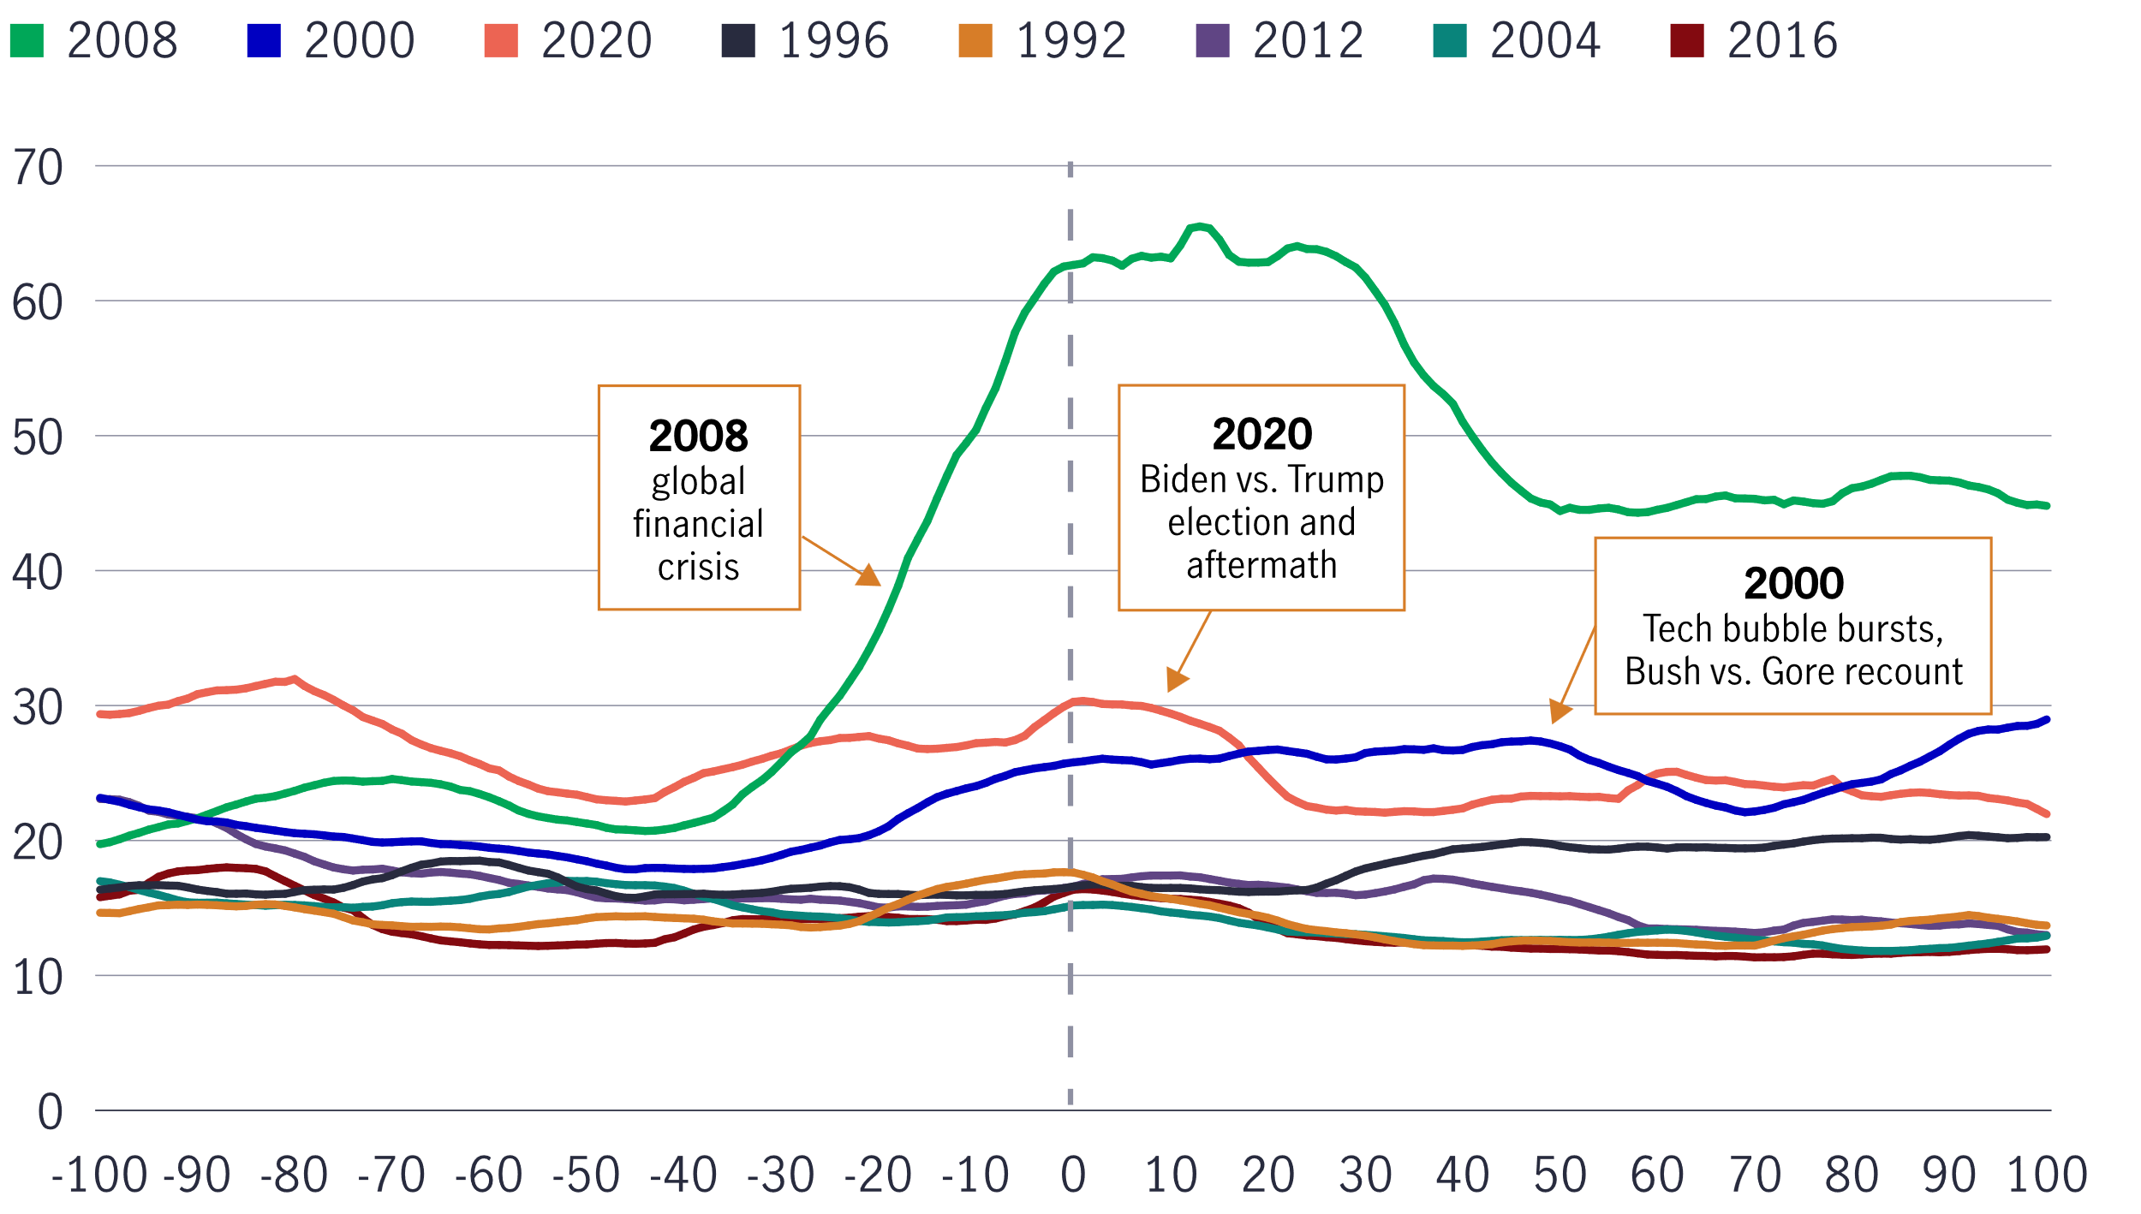
Stock market volatility has been modest before and after recent presidential elections—with some exceptions
Cboe Volatility Index 30-day moving average in the 100 days before and after U.S. presidential elections, 1992–2020
Source: Cboe Exchange, Inc., 2024. The Cboe Volatility Index (VIX) tracks the performance of the market's real-time expectations of volatility over the coming 30 days. It is not possible to invest directly in an index. Past performance does not guarantee future results.
Notes:
And, is also true that when it comes to stock market volatility, according to the Cboe Volatility Index, volatility has been modest before and after recent presidential elections—with some exceptions notably in 2000, 2008, 2020.

Slide 23
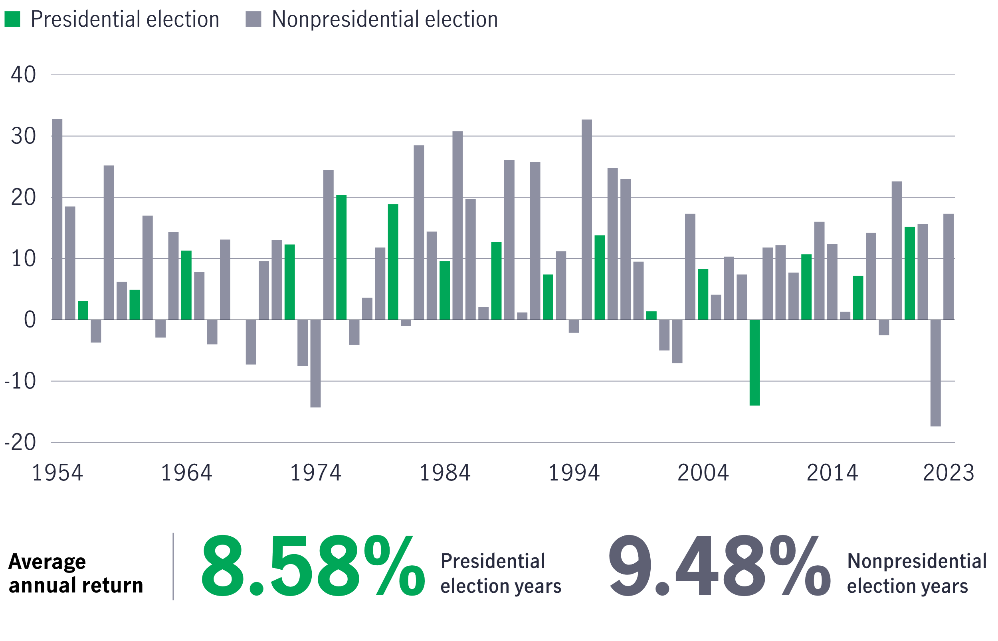
60/40 stock-bond portfolio performance has slightly lagged in presidential election years vs. nonelection years
Annual returns of a 60/40 portfolio, 1954–2023 (%)
Source: Morningstar, 2024. The 60/40 portfolio results are based on performance of a 60% allocation to the S&P 500 Index and a 40% allocation to 10-year U.S. Treasury bonds. The S&P 500 Index tracks the performance of 500 of the largest companies in the United States. It is not possible to invest directly in an index. Past performance does not guarantee future results. This figure is for illustrative purposes only and does not represent any specific investment or imply any guaranteed rate of return.
Notes:
And, 60/40 stock-bond portfolio performance has slightly lagged in presidential election years vs. nonelection years but we are talking about a less than 1% difference in average annual return.
Annual returns of a 60/40 portfolio, 1954–2023 (%)

Slide 24
Which party is better for stocks once in the White House?
President | Start | End | Cumulative return (%) | Annualized return (%)
■ Roosevelt, T. (R) | 9/14/1901 | 3/4/1909 | 21.6 | 2.7
■ Taft, W. (R) | 3/4/1909 | 3/4/1913 | -1.3 | -0.3
■ Wilson, W. (D) | 3/4/1913 | 3/4/1921 | -6.9 | -0.9
■ Harding, W. (R) | 3/4/1921 | 8/2/1923 | 17.4 | 6.9
■ Coolidge, C. (R) | 8/2/1923 | 3/4/1929 | 255.9 | 25.5
■ Hoover, H. (R) | 3/4/1929 | 3/4/1933 | -82.8 | -35.6
■ Roosevelt, F. (D) | 3/4/1933 | 4/12/1945 | 194.4 | 9.3
■ Truman, H. (D) | 4/12/1945 | 1/20/1953 | 81.7 | 8.0
■ Eisenhower, D. (R) | 1/20/1953 | 1/20/1961 | 120.3 | 10.4
■ Kennedy, J. (D) | 1/20/1961 | 11/22/1963 | 12.2 | 4.1
■ Johnson, L. (D) | 11/22/1963 | 1/20/1969 | 30.9 | 5.3
■ Nixon, R. (R) | 1/20/1969 | 8/9/1974 | -16.5 | -3.2
■ Ford, G. (R) | 8/9/1974 | 1/20/1977 | 23.4 | 8.9
■ Carter, J. (D) | 1/20/1977 | 1/20/1981 | -0.9 | -0.2
■ Reagan, R. (R) | 1/20/1981 | 1/20/1989 | 135.1 | 11.3
■ Bush, G. (R) | 1/20/1989 | 1/20/1993 | 45.0 | 9.7
■ Clinton, W. (D) | 1/20/1993 | 1/20/2001 | 226.6 | 15.9
■ Bush, G.W. (R) | 1/20/2001 | 1/20/2009 | -24.9 | -3.5
■ Obama, B. (D) | 1/20/2009 | 1/20/2017 | 149.4 | 12.1
■ Trump, D. (R) | 1/20/2017 | 1/20/2021 | 57.3 | 12.0
■ Biden, J. (D) | 1/20/2021 | - | 21.4¹ | 6.7
 | Weighted Average Republican |  | 57.6 | 6.3
 | Weighted Average Democrat |  | 108.2 | 7.7
Source: Bloomberg, Bespoke Investment, John Hancock Investment Management, 2023.
¹As of January 20, 2024.
Notes:
One last point on elections. One might think the markets perform better under Republican administrations due to “fiscal conservatism”. Interestingly, as you can see, the opposite is true. The markets have historically performed better under Democratic administrations.
The bottom of the chart shows the weighted average cumulative and annualized returns under Republican or Democratic administrations.

Slide 25
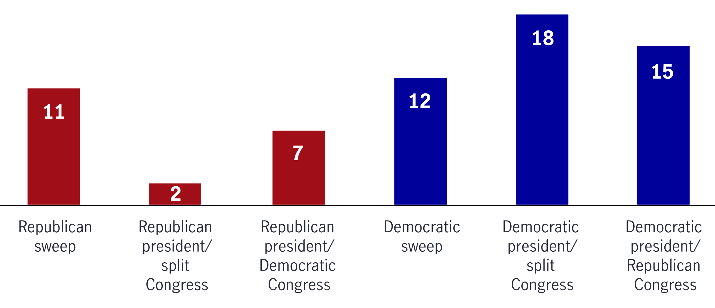
How stocks have performed under six different political scenarios
Average annual returns of the S&P 500 Index when different political parties were in power, 1928–2023 (%)
Source: Morningstar Direct, January 2024. The S&P 500 Index tracks the performance of 500 of the largest companies in the United States. It is not possible to invest directly in an index. Past performance does not guarantee future results.
Notes:
But, what happens when we look beyond Presidential administrations to include Congress (after all they hold the “power of the purse”!)
Looking back to 1933 (the 4-year term starting in 1928), let’s take a look at how the S&P has performed when different parties are in power. As you can see, when there is a “sweep” (meaning one party controls both the Presidency and Congress), Democratic “sweeps” outperform Republican sweeps slightly at 12% vs 11% average annual returns. However, when you have a split Congress, Democrats significantly outperform at 18% average annual rate of return to 2% for Republicans. And when you have one party in the White House and the other controlling Congress? Democratic administrations again out-perform Republicans with a 15% average rate of return vs a 7% average rate of return.
The final point on the impact of politics on the market… we want to make sure you know that we aren’t suggesting that markets perform better under certain types of government--the reality is that the world is much more complex than that.

Slide 26
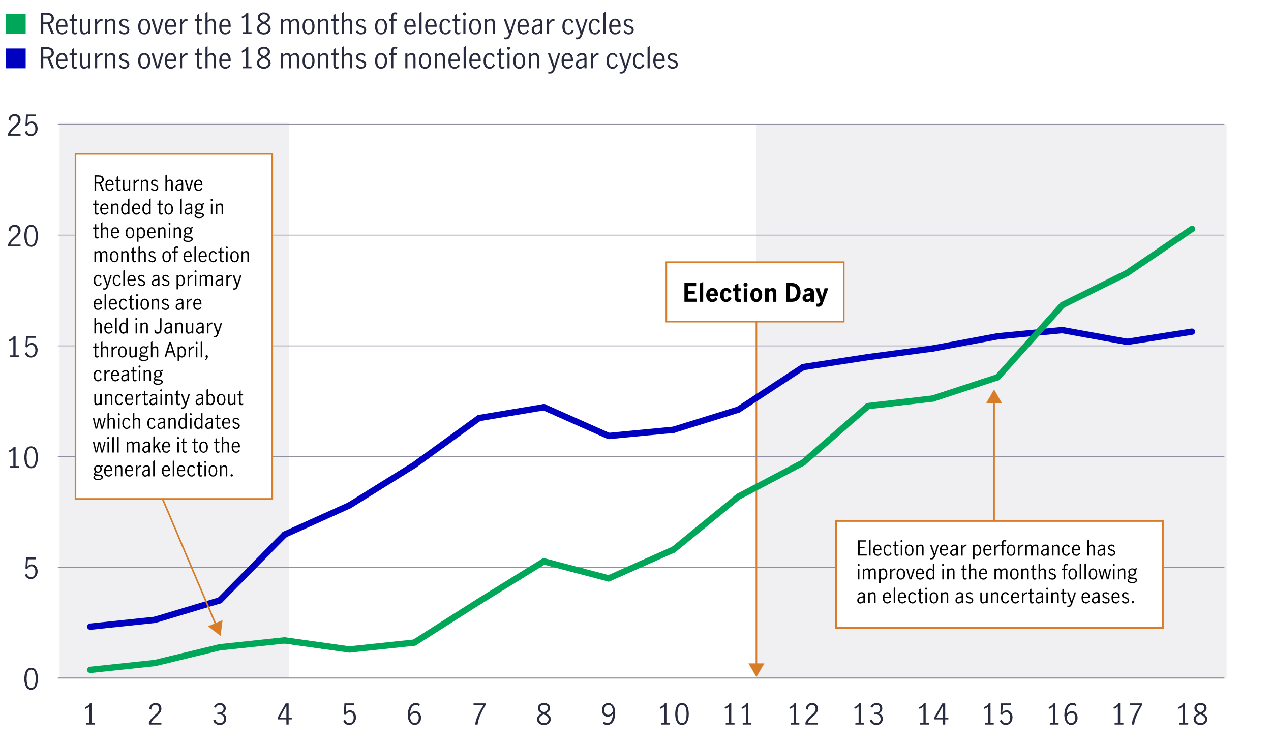
Relative to nonelection years, stocks have tended to lag prior to Election Day but come back following the vote
Cumulative average returns of the S&P 500 Index during 18-month periods before and after presidential and midterm elections versus nonelection periods, 1/31/28–12/31/23 (%)
Source: Morningstar, 2024. The 18-month periods used to calculate election year cumulative average monthly returns began in January of each year of a November presidential or midterm election and ended in June of the following post-election year. The nonelection 18-month periods began in January of each nonelection year and ended in June of the following year. The S&P 500 Index tracks the performance of 500 of the largest companies in the United States. It is not possible to invest directly in an index. Past performance does not guarantee future results.
Notes:
How do election years compare to non-election years? Well, you may be interested to see that relative to nonelection years, stocks have tended to lag prior to Election Day but come back following the vote
Cumulative average returns of the S&P 500 Index during 18-month periods before and after presidential and midterm elections versus nonelection periods, 1/31/28–12/31/23 (%)

Slide 27
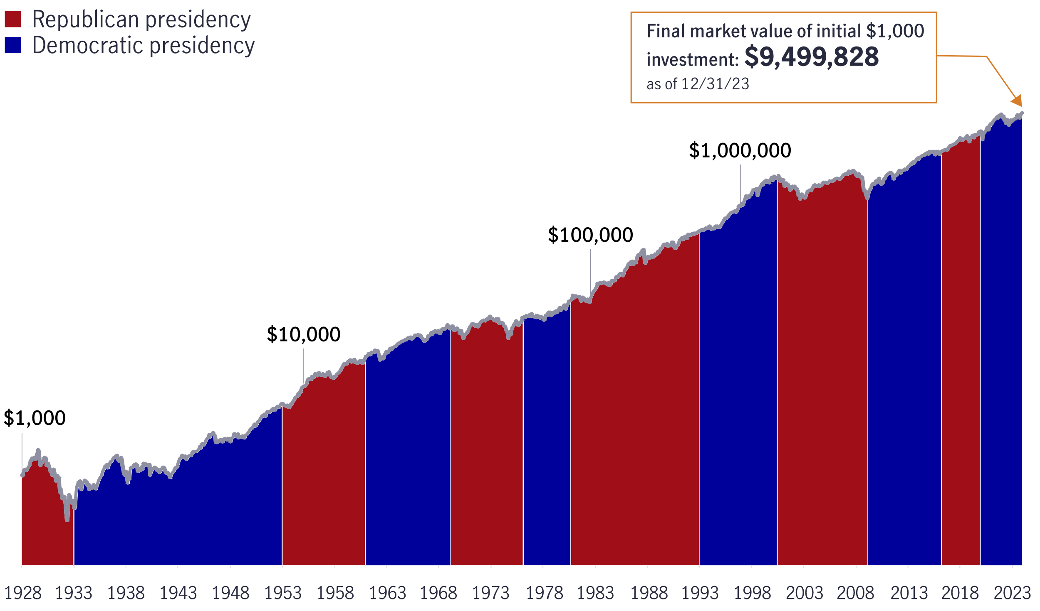
Stocks have risen over the long term no matter which party has been in the White House
Growth of a hypothetical $1,000 investment in the S&P 500 Index, 1/31/28–12/31/23
Source: Morningstar, 2024. A logarithmic scale has been applied to the growth of $1,000 in order to more clearly show changing values during the early decades of the 1928–2023 time span. Dates of political party control of the White House correspond with presidential inauguration months. The S&P 500 Index tracks the performance of 500 of the largest companies in the United States. It is not possible to invest directly in an index. This figure is for illustrative purposes only and does not represent any specific investment or imply any guaranteed rate of return.
Notes:
However, as we have discussed several times already today, the most important thing to remember is that stocks have risen over the long term no matter which party has been in the White House
This chart shows the hypothetical growth of a $1,000 investment in the S&P 500 Index, 1/31/28–12/31/23

Slide 28
Markets recover from crises
Market events and recovery from the bottom
Event | Reaction dates | Loss during the event | 1 month later | 1 year later | 5 years later | 10 years later
Fall of France | 5/9/40–6/22/40 | -16.90% | 0.70% | 5.00% | 15.70% | 13.20%
Outbreak of Korean War | 6/23/50–7/13/50 | -12.20% | 10.20% | 42.20% | 27.70% | 18.50%
Cuban missile crisis | 8/23/62–10/23/62 | -9.90% | 15.50% | 41.10% | 15.80% | 11.10%
Nixon resigns | 8/9/74–8/29/74 | -13.40% | -6.80% | 30.20% | 14.60% | 14.60%
Dot-com bubble | 3/10/00-10/4/02 | -40.62% | 13.60% | 31.07% | 16.10% | 8.36%
September 11 attacks | 9/10/01–9/21/01 | -11.60% | 11.30% | -11.10% | 8.30% | 3.60%
Collapse of Lehman Brothers | 9/5/08–11/20/08 | -39.10% | 18.30% | 48.80% | 21.70% | 15.83%
COVID-19 pandemic | 02/19/20-03/23/20 | -33.79% | 25.23% | 77.78% | TBD | TBD
Source: John Hancock Investment Management, 2023. The S&P 500 Index tracks the performance of 500 of the largest publicly traded companies in the United States. It is not possible to invest directly in an index. This is a hypothetical example and does not reflect the performance of any John Hancock fund. Past performance does not guarantee future results.
Notes:
Now let’s broaden our horizon and take a look at geo-political events. Granted, world events can make investing feel scary sometimes. At times like those, remember that the markets have been exceptionally resilient over time.
Consider the market events presented here, from the fall of France in World War II to the Cuban missile crisis to the collapse of Lehman Brothers in 2008 and the COVID-19 pandemic. In each of those cases, many investors probably thought the world was about to end, but each time the market recovered, usually quickly and powerfully.
Take the COVID-19 crisis which sent the world and world financial markets into a tailspin. Remember how scary it was when the market lost over 30% in March of 2020? But then, one month later, the market was up a little over 25% and a year later it was up over 77% - shortest bear market in history. And today? It is up 77.78%!
Events like these are scary, without question. But when they happen, remember that the economy and stock market have exhibited impressive resiliency and the ability to adapt throughout their history, and the next time will probably be no different.

Slide 29
The level of stock market volatility in recent years is unprecedented
S&P 500 Index, 1973-2023
Trading days per year with greater than ±2% returns
Periods of recession
Trading days per year with greater than ±2% returns
Lehman Brothers bankruptcy
COVID-19 pandemic
European sovereign
debt crisis begins
Enron, WorldCom bankruptcies
Black Monday stock market crash
September 11 terrorist attacks
Unemployment hits 10%
Long-Term Capital Management collapse,
President Clinton impeached
President Nixon resigns
Tech bubble bursts
U.S. debt
downgraded
Oil crisis
Iran hostage crisis
Asian currency crisis
RECESSION
11/73–3/75
RECESSION
1/80–7/80
RECESSION
7/81–11/82
RECESSION
7/90–3/91
RECESSION
3/01–11/01
RECESSION
12/07–6/09
RECESSION 02/20-12/20
Source: Bloomberg, John Hancock Investment Management, as of 2023. The S&P 500 Index tracks the performance of 500 of the largest publicly traded companies in the United States. It is not possible to invest directly in an index. Past performance does not guarantee future results.
Notes:
Here is another look at how different geo-political events have impacted markets – and there is no question that the level of stock market volatility in recent years is unprecedented! Take a look at this chart- the Y axis is showing the number of trading days per year with a greater than + or – 2% movement. This chart does a great job of encapsulating the choppiness we’ve felt for much of the past two decades. The light blue bars represent periods of recession.
We see the Asian currency crisis (collapse of Long Term Capital Management) in 1997; the bursting of the Internet bubble in 2000—nobody will forget that one; the Enron and WorldCom bankruptcies; way up here, the Lehman Brothers collapse and the global financial crisis; and then the European sovereign debt crisis and the downgrade of U.S. Treasury debt. More recently, the COVID-19 pandemic brought another surge of volatility in 2020.
There’s a very important thread among many of these volatile times: Now, more than ever, we live in a global economy. The ripple effects of one country’s problems quickly reverberate around the world.
But why are these ripple effects felt more commonly today? In short, individuals, companies, and governments around the world are in a multi-year process of reducing debt built up over the past decade. This deleveraging process, while good for the long-term health of the markets, has made short-term economic activity and market returns less predictable. Low interest rates and high public debt mean policymakers have fewer tools to combat volatility. That means potentially more market shocks around the world—and more ripples.

Slide 30
Stocks have outpaced bonds and inflation over time, despite a litany of volatility-inducing events
Growth of $100,000, 1983-2023
Stocks (S&P 500 Index)
Bonds (Bloomberg Barclays U.S. Aggregate Bond Index)
Inflation (Consumer Price Index)
Recessions
2020 COVID-19 pandemic
2011 U.S. debt downgraded
1998 President Clinton impeached
2009 European sovereign debt crisis begins
$6,845,679
1997 Asian currency crisis
2008 Lehman Brothers bankruptcy
1994 Mexican peso crisis
2003 Iraq invasion
2002 Enron, WorldCom bankruptcies
1991 Persian Gulf War
2001 September 11 terrorist attacks
1990 Iraq invades Kuwait
2000 Tech bubble bursts
1985 Savings and loan crisis begins
$1,261,441
$298,766
Source: Bloomberg, John Hancock Investment Management, 2023. Stocks are represented by the S&P 500 Index, which tracks the performance of 500 of the largest publicly traded companies in the United States. Bonds are represented by the Bloomberg Barclays U.S. Aggregate Bond Index, which tracks the performance of U.S. investment-grade bonds in government, asset-backed, and corporate debt markets. Inflation is represented by the Consumer Price Index, which is a comprehensive measure used for estimation of price changes in a basket of goods and services representative of consumption expenditure in an economy. It is not possible to invest directly in an index. Past performance does not guarantee future results.
Notes:
But, as you know, despite all the volatility you have just seen, one thing is certain about stocks: Over the long term, they have offered one of the best ways to build wealth. Stocks have outpaced bonds and inflation over time despite wars, political events, recessions, inflation spikes and other market-rattling crises.
As you can see, an investor who put $100,000 in stocks in 1983 and matched the market’s return would have over $6.8 million today. That’s well ahead of the approximately $1.3 million that same investor would have if they invested only in bonds.
The impact of inflation makes that growth even more noteworthy. The investor would have needed more than $298,000 to purchase what $100,000 could have bought back in 1983. Stocks’ returns gave the investor a much larger cushion.

Slide 31
Ignore short-term events and focus on the long-term
Despite investing before a crisis, history has shown you will make money over the long-term
S&P 500 Index cumulative return
Oil crisis, Jan. 1973–Jun. 1976 Number of months to recover: 42
Stock market crash, Oct. 1987–Apr. 1989 Number of months to recover: 19
$
$
TODAY’S VALUE $2,036,349
TODAY’S VALUE $322,751
Dot-com crash, Oct. 2000–Oct. 2006 Number of months to recover: 73
Banking and credit crisis, Dec. 2007–Feb. 2012 Number of months to recover: 51
$
$
TODAY’S VALUE $51,742
TODAY’S VALUE $44,396
Source: John Hancock Investment Management, as of 12/31/2023. The S&P 500 Index tracks the performance of 500 of the largest publicly traded companies in the United States. It is not possible to invest directly in an index. This is a hypothetical example and does not reflect the performance of any John Hancock fund. Past performance does not guarantee future results.
Notes:
In times like these, many investors consider putting off investing because they’re worried that the market will collapse right after they invest.
History says not to worry. Over the long term, investing even right when the market has peaked has been far better than not investing at all.
For example, the oil crisis in the early 1970s was a terrible time for stocks. However, if you put $10,000 in stocks right before the market nose-dived, and your portfolio’s performance matched the market’s return in the decades that followed, today you’d have more than $2.0 million, as you can see above.
Likewise, investing immediately before the stock market crash of 1987, the bursting of the dot-com bubble in 2000, or the financial crisis of 2008 would have been unpleasant at first, but in each case if you held on to your investment, you’d have far better results than if you’d kept your money under your mattress.

Slide 32
Investors who abandon stocks in a downturn may miss out on their eventual recovery
One of the most difficult things for an investor to do is to avoid panicking during a market downturn and selling stocks when they’re at their lowest point
Growth of $100,000 (12/31/07–12/31/23)
Stayed invested in stocks
Moved to bonds
Moved to cash
Financial Crisis
Recovery
768.69% $432,882
Get me out! 2/28/09
50.58% $75,036
$49,832
14.02% $56,895
12/07 | 2/09 | 12/09 | 12/10 | 12/11 | 12/12 | 12/13 | 12/14 | 12/15 | 12/16 | 12/17 | 12/18 | 12/19 | 12/20 | 12/21 | 12/22
Source: Morningstar, Inc., 2023. Stocks are represented by the S&P 500 Index, which tracks the performance of 500 of the largest publicly traded companies in the United States. Bonds are represented by the Bloomberg U.S. Aggregate Bond Index, which tracks the performance of U.S. investment-grade bonds in government, asset-backed, and corporate debt markets. Cash is measured by the Intercontinental Exchange (ICE) Bank of America (BofA) 3-Month U.S. Treasury Bill Index, which is an unmanaged index that seeks to measure the performance of outstanding U.S. Treasury bills that mature closest to, but not beyond, three months from the
rebalancing date. It is not possible to invest directly in an index. Past performance does not guarantee future results.
Notes:
However, as many of us know from experience, one of the most difficult things to do is to avoid panicking during a market downturn and selling stocks when they’re at their lowest point. For example, many investors abandoned stocks and moved to bonds or cash during the worst of the 2008/2009 financial crisis, when staying invested would have provided the best outcome over the long term.
(Note to speaker: You can also use this slide to show the impact of emotion. “Imagine if you bought in 2007 and sold in 2009. You got the double-whammy of locking in a big loss and missing out on great returns when the markets came back”. )

Slide 33
U.S. equities have historically recovered
Bull markets have outlasted bear markets for more than 70 years (%)
400
350
300
250
200
150
100
50
0
-50
-100
1946 1950 1954 1958 1962 1966 1970 1974 1978 1982 1986 1990 1994 1998 2002 2006 2010 2014 2018 2023
This mountain chart shows the cumulative gains of the S&P 500 Index from the 14 equity bull markets from 1946 through 2023 and the corresponding declines from the 13 bear markets during the same period. In each bull-bear market cycle, the bull market gains more than offset the bear market declines, as the average bull market return was +129.44% versus a –28.39% average decline in bear markets.
.
Bulls vs. bears (1946–2023) | Bull markets | Bear markets
Occurrences | 14 | 13
Average length (months) | 53 | 13
Average return (%) | 129.44 | -28.39
The covid bear market began in mid-February and ended in early April 2020; the S&P 500 Index fell as much as 34% before recovering.
Source: Standard & Poor’s, as of 12/31/23. A bull market is generally defined as an increase of 20% or more from an equity market low. A bear market is generally defined as a decline of 20% or more from an equity market peak. The S&P 500 Index tracks the performance of 500 of the largest publicly traded companies in the United States. It is not possible to invest directly in an index. Past performance does not guarantee future results
Notes:
Bottom line….any investor who’s lived through a bear market knows how unpleasant it can be.
History shows, however, that U.S. equities have always recovered and that bull markets have created far more wealth over time than bear markets have taken away.
If history is any guide, we expect that you may see similar results…

Slide 34
Is there a right time or a wrong time to invest?
On average, presidential election cycles have been positive for stocks
Markets have historically recovered from crises
Try to ignore the short-term and focus on the long-term
"The best time to invest is when you have the money”
-Sir John Templeton
Notes:
So, in the end, did we answer the question, “Is there a right time or a wrong time to invest?” Well, first, we learned that, on average, presidential election cycles (which often worry investors) have been positive for stocks, much more than they have been negative. We also looked at a lot of different geo-political crises and learned that, despite how scary it feels when you are in them, markets eventually recover from crises.
We showed you with actual data that, even if you invested at the worst time, you still made money in the long run if you stayed invested.
So, to answer the question, is there a right time or a wrong time to invest?, I would like to share a quote from Sir John Templeton (1912-2008), an American-born British investor who founded Templeton Funds (now Franklin Templeton); – “The best time to invest is when you have the money!”

Slide 35
What do inflation and rising rates mean?
Notes:
And now for our 4th “history lesson” the one we know is on everyone’s mind right now, what do inflation and rising rates mean?

Slide 36
What is inflation?
What is inflation?
Increase in the price of goods and services
Causes your buying power to erode
Too much money chasing too few goods
6 Main causes of inflation:
Demand-pull inflation
Cost-push inflation
Increased money supply
Rising Wages
Devaluation
Policies and regulation
Source: Businessinsider.com, What to know about the 6 main causes of inflation, 2022
Notes:
Let’s start this “history lesson” with a primer on inflation….Inflation can be caused by multiple factors. However, the causes of inflation in 2022 were a bit more complex and were caused in part because of the government’s response to the pandemic (4 stimulus packages under the Trump administration, and a fifth stimulus package under the Biden administration in addition to quantitative easing by the Fed), sudden increases in demand as we came out of COVID lockdown restrictions, labor shortages, supply chain problems, and, of course, the Russian invasion of Ukraine and the subsequent sanctions, which has wrecked havoc on energy prices and food prices.
The basic definition of inflation is an increase in the price of goods and services which causes your buying power to erode. Essentially there is too much money chasing too few goods.
There are 6 main causes of inflation. Demand-pull inflation which is when the demand for goods and services is greater than the economy’s ability to meet those demands. When demand out-paces supply, there is an upward pressure on prices – inflation. Cost-push inflation happens when the cost of wages and materials go up therefore causing an increase in prices. (Example – when the cost of lumber spiked 400% in 2021, it drove the cost of homes up). Increased money supply happens when money supply increases faster than the rate of production.
Rising wages can cause inflation because they increase the cost of production – businesses either have to pass the cost on or live with lower margins. Devaluation is the downward adjustment in a country’s exchange rate, resulting in lower values for their currency, making their exports less expensive and encouraging foreign nations to buy more of their de-valued goods. It also makes foreign products more expensive to the devaluing country encouraging citizens to buy domestic products (China is well known for this tactic).. And finally, certain government policies can result in inflation – for example, stringent building regulations can increase costs which get passed on).

Slide 37
Let’s talk about the role of the Federal Reserve
Why does the Federal Reserve raise interest rates to combat inflation? Doesn’t the higher cost of borrowing just create more inflation?
By raising rates, the Fed hopes to discourage consumers from making large purchases and compelling people to cut back on spending. The goal is to lower demand over time, allowing prices to come down and stabilize. Instead of cutting rates to encourage growth (as they did during the pandemic), the Fed is trying to reverse course and cool the economy.
What is the risk?
Pushing rates up too fast could slow growth too much and too fast leading the country into recession.
Source: Washingtonpost.com, What will the Fed’s rate hike mean for consumers, June 15, 2022
Notes:
Okay – now that we have reviewed how inflation works, let’s talk about the role of the Federal Reserve. Many people do not understand why the Federal Reserve raises interest rates to combat inflation. Doesn’t the higher cost of borrowing just create more inflation?
We can help you answer that… as you know, by raising rates the Fed hopes to discourage consumers from making large purchases and compelling people to cut back on spending. Rising rates also discourage business expansion because companies are less willing to borrow and therefore may put some projects/purchases on hold. The goal is to lower demand over time, allowing prices to come down and stabilize. Instead of cutting rates to encourage growth (as they did during the pandemic), the Fed is trying to reverse course and cool the economy.
What is the risk?
Pushing rates up to fast could slow growth too much and too fast leading the country into recession.

Slide 38
What about recession risk?
100 year average: 12.6 months
Source: FactSet, 6/23/2022
Notes:
Which leads us to recession risk. Let’s start by defining recession….
The old rule of thumb was two consecutive quarters of negative GDP growth equaled a recession. However, the COVID recession of 2020 only lasted two months so the National Bureau of Economic Research (NBER) changed the definition. The first part of the new definition of a recession is relatively simple, “the period between a peak of economic activity and its subsequent trough, or lowest point.” In terms of measuring the contraction though NBER says, “a recession involves a significant decline in economic activity that is spread across the economy and lasts more than a few months. In our interpretation of this definition, we use the three criteria—depth, diffusion, and duration.” The second part of the definition is incredibly subjective.
Recessions are an important segment for economic cycle-based market analysis. They have their own defining market characteristics.
The problem of course is we won’t know we are in a recession until after the fact (likely quarters later). As to where we are now in 2024, while many economists predicted a recession in 2023, that did not come to fruition. Consumer spending and the labor market have remained strong despite inflation and rate hikes. Recession is considered less likely in 2024 as data now points to a successful soft landing.
So, while we cannot be sure yet, what we can do is look back at history to see what the shortest and longest recessions were. The shortest one was the Covid recession from 3/2/2020 to 5/1/2020 lasting just 2 months, and the longest was the Great Depression(9/3/1926 – 4/3/1933) at 43 months. But, again, over the last 100 years, the average length of a recession has been 12.6 months.
Now, we do understand that inflation, rising interest rates, and recessions (when they happen) cause real pain for you and your family, whether that is in the form of gas prices, food prices, the cost of housing, cost of borrowing, etc. And I do not want to diminish that pain in any way. But what I would like to do is focus on what it means for your investment portfolio.
Earlier we talked about how markets react to elections and geo-political crises. Now, let’s look at how the markets reacted to inflation and rising interest rates in the past…

Slide 39
How have equity markets reacted to inflation and rising rates historically?
Monthly US S&P 500 returns against Monthly Changes in Effective Federal Funds Rate, August 1954–February 2023
When the Fed Funds rate goes up, do stock prices go down? The answer is only about 42% of the time. In the remaining 58% of months when the Fed Funds rate went up, stock returns were positive.
Sources: Morningstar Direct, S&P monthly returns from August 1954 – December 2023. Federal Reserve Bank of St Louis, Fed funds rate August 1954 – December 2023.The S&P 500 Index tracks the performance of 500 of the largest publicly traded companies in the United States. It is not possible to invest directly in an index.
Notes:
First, stock prices might rise or fall with changes in interest rates. For stocks, it can go either way because a stock’s price depends on both future cash flows to investors and the discount rate they apply to those expected cash flows. When interest rates rise, the discount rate may increase, which in turn could cause the price of the stock to fall. However, it is also possible that when interest rates change, expectations about future cash flows expected from holding a stock also change. So, if theory doesn’t tell us what the overall effect should be, the next question is what does the data say? We examined the correlation between monthly US stock returns and changes in interest rates by looking at the monthly S&P returns compared to the Fed Funds rate going back to August 1954.
So, the question is, when rates go up, do stock prices go down? The answer is only about 42% of the time. In the remaining 58% of months, stock returns were positive. This split between positive and negative returns was about the same when examining all months, not just those in which rates went up. In other words, there is not a clear link between stock returns and interest rate changes.

Slide 40
What happens to fixed income when interest rates go up? Bonds have a built-in recovery mechanism….
Starting Duration | 6.1
Starting Yield | 4.60% |  | 0 Yr | 1 Yr | 2 Yr | 3 Yr | 4 Yr
 |  | 0.25% | -1.53% | 3.33% | 8.18% | 13.03% | 17.88%
 |  | 0.50% | -3.05% | 2.05% | 7.15% | 12.25% | 17.35%
 |  | 0.75% | -4.58% | 0.78% | 6.13% | 11.48% | 16.83%
 |  | 1.00% | -6.10% | -0.50% | 5.10% | 10.70% | 16.30%
 |  | 1.25% | -7.63% | -1.78% | 4.08% | 9.93% | 15.78%
 |  | 1.50% | -9.15% | -3.05% | 3.05% | 9.15% | 15.25%
Source: John Hancock Investments. For illustrative purposes only. Column 0 Yr is calculated by multiplying the starting duration by the one-time change in interest rates and subtracting from zero. Subsequent columns are calculated by adding back the one-time change in interest rates + starting yield.
Increase in rates
Source: MorningStar Direct as of 3/15/23. Past performance is not indicative of future results. The Bloomberg U.S. Aggregate Bond Index tracks the performance of U.S. investment-grade bonds in government, asset-backed, and corporate debt markets. It is not possible to invest directly in an index. Duration measures the sensitivity of the price of bonds to a change in interest rate
Notes:
Ok – so now let’s look at what happens to bonds when interest rates go up? The first thing to remember is that bonds and interest rates have an inverse relationship. When interest rates go up, the value of your bonds declines. We tend to treat bonds really badly: we complain about the low interest rates and yet we fret about them going up.
When equities go down, the results can be quite painful, and we really don’t know when we will make our money back. Remember the “lost decade”? From Jan 1, 2000 to Dec 31, 2009, the return on the S&P 500 was negative. That changed the retirement calculus for a lot of people.
But remember not to apply equity logic to bonds, because it’s not the same. The gains that you make in higher coupons (interest rate/yield) create a built-in recovery mechanism for bonds. Remember that when rates go up, your principal may go down, but you will then be collecting a higher interest rate. In fact, you’ll recover quite quickly.
[explain chart]
You do not want to ignore this dynamic and assume bond bear markets are as bad as equity bear markets.
This dynamic also means bond bear markets tend to be short-lived. In fact, the agg has only twice very briefly had a negative 3-year return over the past 42 years. Just like stocks, over any one-year period, you never know what could happen to bonds.
Bottom line, higher rates are grabbing headlines, but with the appropriate time horizon you can help maximize your return potential.

Slide 41
Holding bonds to maturity has typically earned initial yield despite paper losses
Over the last 40 years, there’s been a strong relationship between starting bond yields and subsequent 5-year annualized returns
Largest Agg drawdowns
Month ended | Drawdown (%)
11/30/16 | -3.28
7/31/03 | -3.55
8/31/13 | -3.67
10/31/08 | -3.83
5/31/84 | -4.88
9/30/87 | -4.90
6/30/94 | -5.15
8/31/80 | -12.74
10/31/22 | -16.59
89% of a bond’s performance is attributable to its starting yield, and today, the Bloomberg U.S. Aggregate Bond Index is yielding 4.59%.
Source: FactSet, as of 2/29/24. The Bloomberg U.S. Aggregate Bond Index (Agg) tracks the performance of U.S. investment-grade bonds in government, asset-backed, and corporate debt markets. It is not possible to invest directly in an index. Drawdown is a measure of market declines from a peak to a subsequent trough. Month of trough is shown, Past performance does not guarantee future results.
Notes:
st, stock prices might rise or fall with changes in interest rates. For stocks, it can go either way because a stock’s price depends on both future cash flows to investors and the discount rate they apply to those expected cash flows. When interest rates rise, the discount rate may increase, which in turn could cause the price of the stock to fall. However, it is also possible that when interest rates change, expectations about future cash flows expected from holding a stock also change. So, if theory doesn’t tell us what the overall effect should be, the next question is what does the data say? We examined the correlation between monthly US stock returns and changes in interest rates by looking at the monthly S&P returns compared to the Fed Funds rate going back to August 1954.
So, the question is, when rates go up, do stock prices go down? The answer is only about 42% of the time. In the remaining 58% of months, stock returns were positive. This split between positive and negative returns was about the same when examining all months, not just those in which rates went up. In other words, there is not a clear link between stock returns and interest rate changes.

Slide 42
In portfolios, playing defense is important
*The MorningStar US Intermediate Core Bond Category Average
Source: MorningStar Direct as of 4/1/22. Equity market declines are weeks in which the S&P 500 Index posted a negative return. You cannot invest directly in an index. Past performance is not indicative of future results. The S&P 500 Index tracks the performance of 500 of the largest publicly traded companies in the United States. It is not possible to invest directly in an index.
Notes:
Another note as it relates to your overall fixed income/bond portfolio…
In portfolios, playing defense is important…
[explain chart]
Higher quality bonds do this a lot better than other bond asset classes.
Why is this important? You all know portfolio math—2% down and then 2% up doesn’t get to your starting point. This is called volatility drag.
You never know when your portfolio can benefit from this dynamic. Even in 2022, bonds were up when equities were down ~20% of the time—a small amount relative to history, but every little bit helps.
The total average for the entire time period is 60.4%. Over this long time period, the correlation between stocks and bonds is right around zero. So, while that is a lot of diversification benefit, it’s not a negative correlation. That is to say, we shouldn’t always expect bonds to go up when stocks go down.
Equally as important, the recent limitation in bonds ability to diversify has been painful for sure (because the percentage this year has been at a historical low), but the other painful periods on the chart include 1994, 1999, 2005, 2016. All time periods in which the Fed was boosting rates to ward off higher inflation expectations which is what is going on now. These periods tend to be short-lived.

Slide 43
What do inflation and rising rates mean for my portfolio?
Inflation (loss of buying power) has many different causes
The Fed raises interest rates in the hopes of cooling growth and stabilizing prices
When rates rise, stock portfolios can both rise and fall. Historically, about 42% of the time, they have fallen. In the remaining 58% of months, stock returns were positive.
Bond portfolios will fall in price but some of the decline will be offset by the coupons on the bonds.
Source: 1. The Planning Center, When rates go down, do stocks go up?, 2022. Based on research from Dimensional Fund Advisors LP. 2. MorningStar Direct as of 4/1/22. You cannot invest directly in an index. Past performance is not indicative of future results. The Bloomberg U.S. Aggregate Bond Index tracks the performance of U.S. investment-grade bonds in government, asset-backed, and corporate debt markets. It is not possible to invest directly in an index.
Notes:
So, in the end, did we answer the question, “what do inflation and rising rates mean for my investment portfolio? Well, first, we went through a primer on inflation to understand what it is and what causes it. Then we explored why the Fed raises interest rates to cool inflation, and the fact that, if the Fed over-corrects, we can end up in a recession.
So, to answer the question, what do inflation and rising rates mean for my portfolio, we learned that equity portfolios can both rise and fall when rates are rising. Historically, about 42% of the time stock portfolios have fallen while the other 62% of the time stock portfolios were positive.
And, bond portfolios can fall in price but some of the decline can be offset by the coupons on the bonds.
And finally, we discussed that the best way to make sure that your portfolio recovers is to stay invested so that you do not miss the best days in the market…. the key to investment success isn’t timing the market, it’s time in the market.
But, it is never quite that simple, is it?

Slide 44
What do I do now?
Notes:
So, now that we have shared some “history lessons”, the question is, what do you do now?

Slide 45
It’s natural to feel emotional about your investments
EUPHORIC
“I should quit my job and do this full time! Look at the money I’m making!”
Best opportunity to make money
Nervous
Confident
“What happened? What is going on?”
“I’ve already made money. This is great.”
Hopeful
Riskiest time
Desperate
“Things seem like they’re turning around.”
“There’s no point in selling now, I’ve lost too much.”
DEFEATED
“There go my dreams of an early retirement.”
This hypothetical scenario is for illustrative purposes only and is not a prediction of future market conditions.
Notes:
First, it is important to help manage your emotions. It’s human nature to feel emotional about your investments, but, acting on those emotions is typically counterproductive.
To manage the impact of emotion on investment performance, it may help to learn to recognize the emotional investment cycle. [Walk through slide]

Slide 46
Emotions tend to make investors abandon and reenter stocks at the worst times
Net fund flows ($M), 2003-2023
$
Investors move back in
as index peaks
Investors flee stocks
1
Source: Bloomberg as of 12/31/2023. The S&P 500 Index tracks the performance of 500 of the largest publicly traded companies in the United States. It is not possible to invest directly in an index. Past performance does not guarantee future results.
1 Comprises U.S. equity, sector equity, international equity, and hybrid mutual funds and ETFs. ISS Market Intelligence, showing only the allocation, sector equity, U.S. equity, and international equity Morningstar groups, excluding fund of funds.
Notes:
Decades of research into investor behavior finds that people’s emotions lead them to buy and sell at precisely the wrong times.
The bars in the chart here show fund flows. Bars below the horizontal line in the center represent equity outflows—when investors pulled money out of stock funds. As you can see, investors invariably took money out of the market after stocks had fallen, locking in their losses and missing the recoveries.
Then they waited until stocks had posted steady gains for a while and only then got back into the market—usually just in time for market dips.
A better approach: Don’t try to time the market.

Slide 47
Limiting losses is paramount
How long can it take to recover from losses?
Assuming | 10% loss | 20% loss | 30% loss | 40% loss
3% yearly return | 4 years | 7 years | 9 years | 12 years
5% yearly return | 2 years | 4 years | 6 years | 7 years
7% yearly return | 2 years | 3 years | 4 years | 5 years
9% yearly return | 2 years | 3 years | 3 years | 4 years
11% yearly return | 1 year | 2 years | 3 years | 4 years
13% yearly return | 10 months | 2 years | 3 years | 3 years
15% yearly return | 9 months | 2 years | 2 years | 3 years
Source: John Hancock Investment Management, 2023.
Diversification does not guarantee a profit or eliminate the risk of a loss.
© 2023 Morningstar. All Rights Reserved. The information contained herein: (1) is proprietary to Morningstar and/or its providers; (2) may not be copied or distributed; and (3) is not warranted to be accurate, complete, or timely. Neither Morningstar nor its content providers are responsible for any damages or losses arising from any use of this information.
This material is not intended to be, nor shall it be interpreted or construed as, a recommendation or providing advice, impartial or otherwise. John Hancock Investment Management and its representatives and affiliates may receive compensation derived from the sale of and/or from any investment made in its products and services. This figure is for illustrative purposes only and does not represent any specific investment or imply any guaranteed rate of return.
Notes:
Now, it is important that we also talk about what it takes to recover from these down periods in the market-another challenge facing investors. And the degree to which that impacts you depends largely on the life stage that you are in.
The time to recover depends on how much your portfolio declined and what you are currently invested in and what those corresponding returns look like. (Note to speaker: cover some examples in the slide)
For example, if you rode the markets down, then cashed out, and are now invested in low yielding bonds and cash, it could potentially take much longer.
It’s a reality of math that a big loss in one year means you may need a series of gains in the following years to restore lost wealth. Depending on the size of those gains, and the extent of the loss you’re trying to recover from, it can take a while.

Slide 48
The key is not missing the market’s best days
20-year growth of $10,000, 2003–2023
Source: Bloomberg, as of 12/31/2023. This table is for illustrative purposes only. The S&P 500 Index tracks the performance of 500 of the largest publicly traded companies in the United States. It is not possible to invest directly in an index. This is a hypothetical example and does not reflect the performance of any John Hancock fund. Past performance does not guarantee future results.
Notes:
Which brings us to the most important point….The key to benefiting from the stock market’s growth potential is to stay in the stock market. If you pull your money out of the market, you risk missing its best days—and that can be extremely costly.
Consider an investor who invested $10,000 in 2003 and matched the returns of the S&P 500 Index. Twenty years later, he’d have $63,544.
Now say he jumped out of stocks at times and wound up missing the market’s 10 best days. He’d have less than half as much than he would have otherwise, had he stayed fully invested over 20 years.
If he missed the market’s 30 best days, he’d have around one-sixth of what he would have earned from staying fully invested; if he missed the 40 best days, he’d have around one-eighth.
Clearly, being in the market for its best days is critical, but no one knows when the best days will be. So, the only logical approach is to stay invested for the long haul.

Slide 49
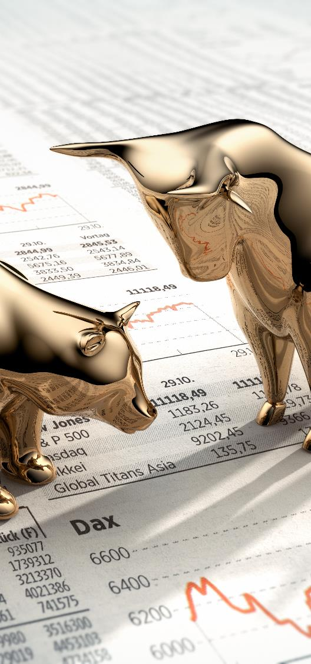
Chasing performance can lead to underperformance
Average annual returns, 2003–2022
Equity investors held their funds for only 4 years before switching
Source: DALBAR’s 2023 QAIB Report, Quantitative Analysis of Investor Behavior, DALBAR, Inc., 2023. Investor returns are calculated using data supplied by the Investment Company Institute that represents the change in total mutual fund assets after excluding sales, redemptions, and exchanges. This method of calculation captures realized and unrealized capital gains, dividends, interest, trading costs, sales charges, fees, expenses, and any other costs. The S&P 500 Index tracks the performance of 500 of the largest publicly traded companies in the United States. It is not possible to invest directly in an index. Past performance does not guarantee future results.
Notes:
One additional point I want to make here is that chasing performance is counterproductive. Behavioral finance researchers have identified something they call recency bias. It means that people tend to think that things that have happened recently will continue into the future. This belief leads investors to purchase investments that have performed well in the past months or years. Unfortunately, those investments may be expensive and ready for a fall.
Chasing performance seems to be the main reason that the average equity fund investor’s return was only about 92% that of the S&P 500 Index during the 20 years through 2022.
We use this visual to help reinforce the benefits of using a financial professional. A good financial professional can potentially help you avoid some of these missteps…

Slide 50
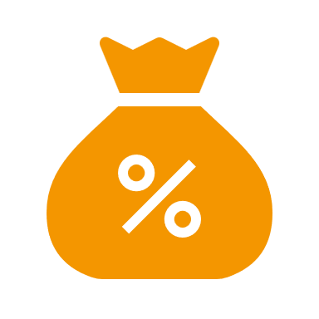
Actions depend on life stage
Accumulation stage investor
For investors who are firmly in the accumulation stage with a long-term outlook:
Don’t panic
If you continue to feel unsettled, revisit your goals, investment time horizon, and risk tolerance with your Financial Professional to make sure your plan is on track and your questions are answered
Make sure your emergency fund is fully funded
Continue to dollar cost average into your retirement plans and any other systematic investment programs. If possible, you may want to increase those contributions in order to take advantage of lower prices.
Notes:
Ok – now that we have that foundation, let’s look at specific actions you may want to take depend upon their life stage.
We will take a look at 3 different life stages and potential actions. Let’s start with the Accumulation stage investor.
For investors who are firmly in the accumulation stage with a long-term outlook here are some potential actions we would encourage you to take:
First and most important, don’t panic! That may cause you to make poor decisions
If you continue to feel unsettled, consider revisiting your goals, investment time horizon, and risk tolerance with your Financial Professional to make sure that your plan is on track and questions are answered
Make sure your emergency fund is fully funded so that you have the resources that you need should something like a job loss occur.
And certainly, continue to dollar cost average into their retirement plans and any other systematic investment programs. If possible, you may want to increase those contributions in order to take advantage of lower prices.

Slide 51
Actions depend on life stage
Nearing retirement or early-stage retirement investor
For investors nearing retirement or in early-stage retirement, there are special considerations
Don’t panic
Meet with your Financial Professional to discuss your concerns and fears
Make sure your emergency fund is fully funded
Have your Financial Professional explain their retirement income process and how they account for market down-turns within that process
Understand the impact of sequence of returns and make adjustments to your plan (if necessary) to minimize that impact
Notes:
Let’s move on to the Nearing retirement or early-stage retirement investor….
For investors nearing retirement or in early-stage retirement, there are special considerations. Let’s go through some potential actions you can take:
Again, we want to stress that you don’t want to panic! That can lead to poor decisions…
Certainly, you should meet with your Financia Professional to discuss your concerns and fears
You also want to make sure your emergency fund is fully funded – coming up with large lump for emergencies in retirement can be challenging
Very importantly, please have your Financial Professional explain their retirement income process and how they account for market down-turns within that process
And, most importantly, make sure you understand the impact of sequence of returns and what adjustments you can make to your plan to minimize that impact (such as delaying retirement, reducing spending taking on part-time work)…
Now if that sounds a bit scary, it is meant to…the sequence of returns in retirement can make the difference between enjoying your retirement without financial worries and running out of money…let’s do a refresher on the sequence of returns so that you can explain it to your clients.

Slide 52
Who is impacted by sequence of returns?
The sequence of returns may have less of an impact on the portfolio of someone who is still working and accumulating assets for retirement.
However, during retirement, the relationship between an individual’s rate of withdrawal and the sequence of returns can have a dramatic impact on a portfolio’s overall ability to last.
Notes:
Let’s start with who is impacted by sequence of returns…
The sequence of returns may have less of an impact on the portfolio of someone who is still working and accumulating assets for retirement.
However, during retirement, the relationship between an individual’s rate of withdrawal and the sequence of returns can have a dramatic impact on a portfolio’s overall ability to last.

Slide 53
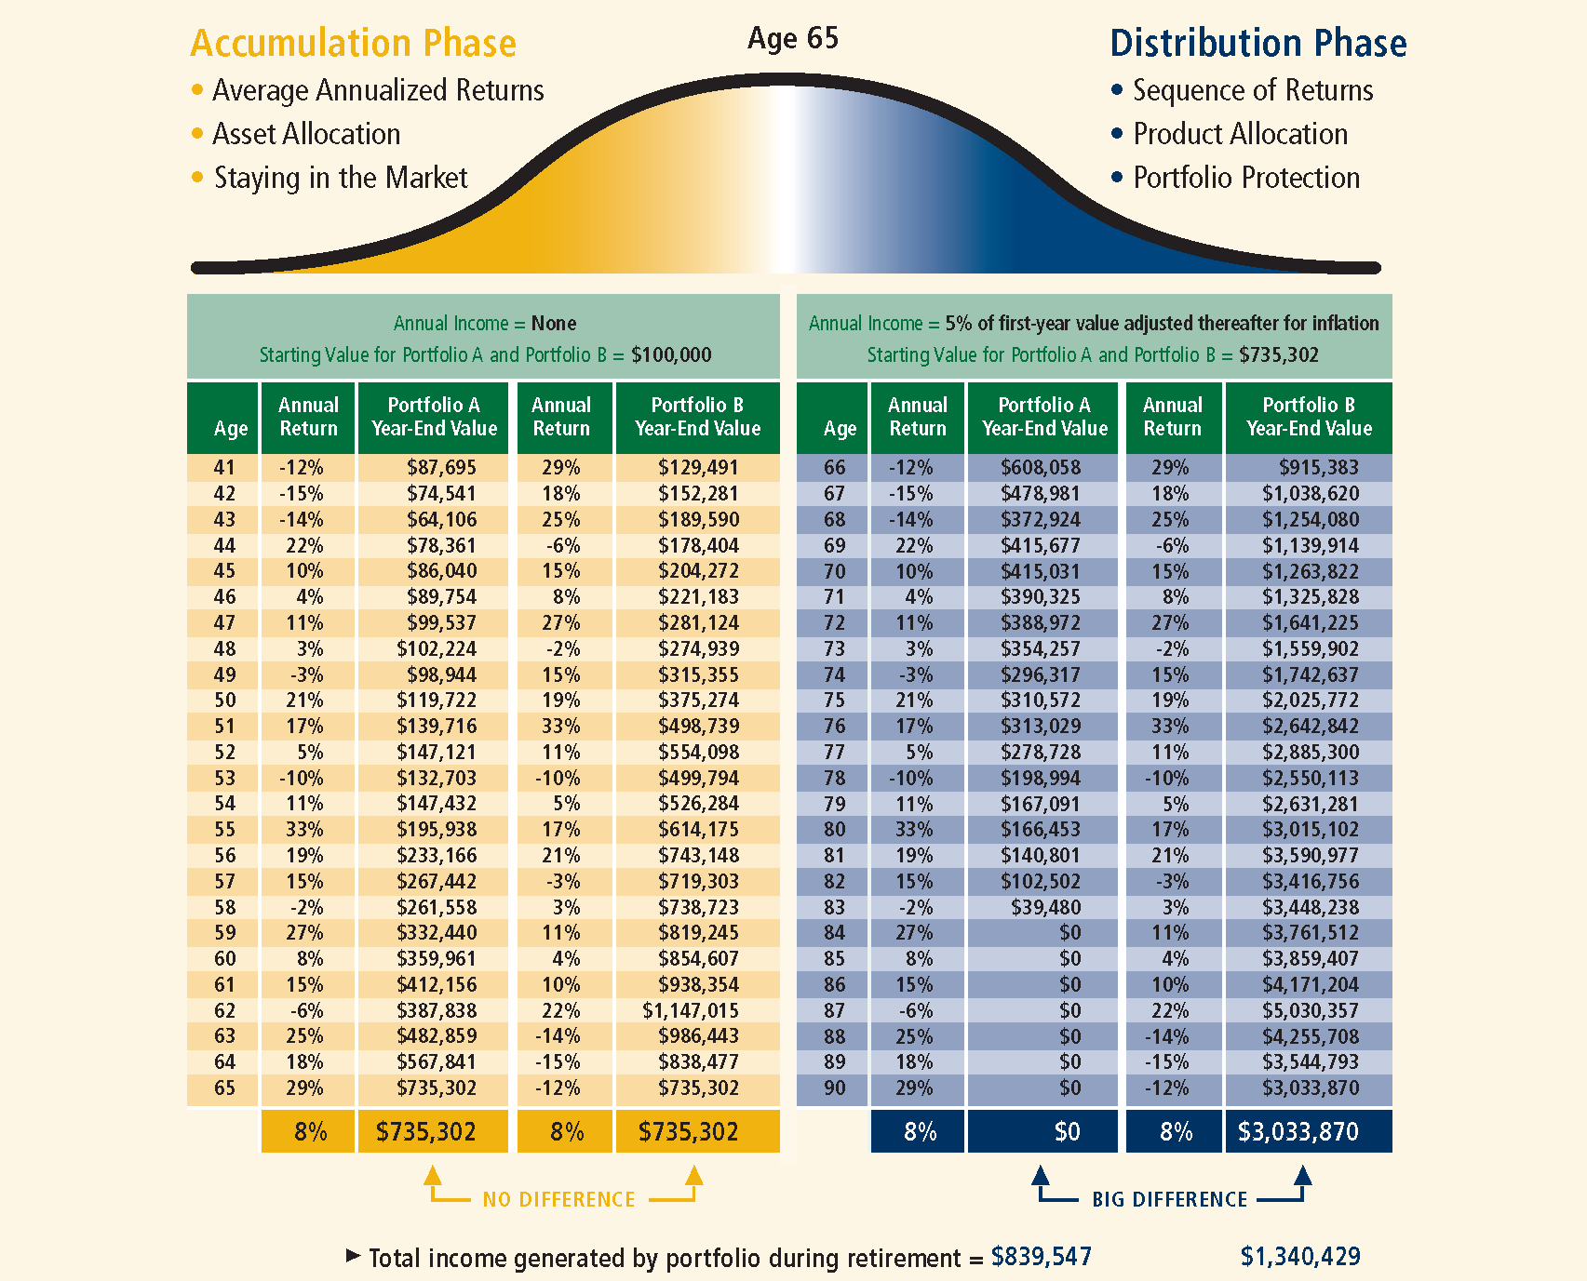
Sequence of returns illustration – Factors affecting portfolio results before and after retirement
Source: Standard & Poor’s. The sequence of returns has an average compounded annualized return of 8% over 25 years and year-to-year volatility that is consistent with a portfolio predominantly comprised of stocks. Annual returns have been rounded to the nearest whole number. The accumulation portfolios assume a starting value of $100,000 at age 40 andno annual withdrawals. The distribution portfolios assume a starting value of either $100,000 or $735,302 at age 65 as well as a 5% first-year withdrawal thereafter adjusted for 3% inflation annually. Except where noted, the average annualized return for the 25-year period is 8%.
All charts are hypothetical and for illustrative purposes only and are not intended to predict or project portfolio results. Charges may apply to amounts taken in excess of the withdrawal amount available without a withdrawal charge during the surrender charge period. All withdrawals reduce the death benefit, optional benefits and contract value. Withdrawals will come first from any gain in the contract. In addition, withdrawals of taxable amounts will be subject to ordinary income tax and, if made prior to age 591⁄2, a 10% IRS penalty tax may apply.
Notes:
Ok, if that is who is impacted, then what is it and how does it work?
Let’s take a look at this chart – I know there is a lot going on here so let me guide you. On the left-hand side (the yellow side), we show 2 scenarios for an investor, age 41, starting with $100,000. There is no income being withdrawn. In both scenarios on the yellow side, the average rate of return over the 25-year period is 8%. However, in the first scenario, the first 3 years were negative years while in the second scenario the first 3 years are positive. At the end – both scenarios have an ending value of $735,302. No problem…
However, that changes dramatically when you look at the blue side of the slide. Again, 2 scenarios – in this case the client is age 66, with a starting value on the portfolio of $735,302. The scenarios also assumes an annual income of 5% in the first year adjusted annually for inflation. Again, on the left side the first 3 years are negative returns while on the right side the first 3 years are positive. The ending average annual return for both scenarios is 8%. However, this time the results are dramatically different…in the first scenario, the client runs out of money at 84 while in the second scenario the client ends up with $3,033,870 at age 90.
Sequence of returns matters in the early years of retirement!

Slide 54
Actions depend on life stage
Mid or late-stage retirement investor
For a mid or late-stage retirement investor:
Don’t panic
Meet with your Financia Professional to discuss your concerns and fears
Make sure your emergency fund is fully funded
Revisit your retirement income strategy for your portfolio. Discuss whether any adjustments should be made.
Schedule check-ins with your Financial Professional at a frequency that will provide you with the peace of mind to continue to enjoy retirement
Notes:
The last life stage we want to discuss is the mid to late-stage retirement investor.
A mid or late-stage retirement investor has hopefully been enjoying their retirement for quite some time. But times like this can still rattle them….
As always, we want to remind you not to panic! Again, that can just lead to poor decisions….
Certainly, meet with your Financial Professional to discuss your concerns and fears
As we discussed for the other life stages, make sure your emergency vehicle is fully funded – you never know when you’ll will need it and the extra cash cushion can provide some peace of mind!
Revisit the retirement income strategy for your portfolio with your Financial Professional. Discuss whether any adjustments should be made. Although you may have dodged the sequence of returns issue, it still important to have this conversation.
And finally, schedule check-ins with your Financial Professional at a frequency that will provide them you with the peace of mind to continue to enjoy retirement!

Slide 55
In summary
What does the history of market returns tell us?
Is there a right time or wrong time to invest?
What do inflation and rising rates mean?
What do I do now?
Is diversification dead?
Notes:
In summary, we have talked about 5 major “history lessons” today:
What does the history of market returns tell us?
Is diversification dead?
Is there a right time or wrong time to invest?
What do inflation and rising rates mean?
What do I do now?
And all of this was done against the backdrop of a lot of historical data. We hope that we have armed you with the information you will need to help calm your fears and keep you on course…

Slide 56
“Those who fail to learn from history are doomed to repeat it.” Winston Churchill British Statesman
Notes:
Before we go to Q&A, I would like to leave you with a quote. Now this quote is often attributed to the Spanish philosopher, George Santayana but I am sharing the Winston Churchill version…..Those who fail to learn from history are doomed to repeat it. I hope the “history lessons” I shared today will help save you from that fate!

Slide 57
Q & A
Notes:
Now let’s open it up for Q&A….

Slide 58
A WORD ABOUT RISK
The Morningstar Style Box™ reveals a fund’s investment strategy as of the date noted on this presentation.
For equity funds, the vertical axis shows the market capitalization of the long stocks owned, and the horizontal axis shows the investment style (value, blend, or growth.) A darkened cell in the style box matrix indicates the weighted average style of the portfolio.
For portfolios holding fixed-income investments, a Fixed Income Style Box is calculated. The vertical axis shows the credit quality based on credit ratings and the horizontal axis shows interest-rate sensitivity as measured by effective duration. There are three credit categories - "High", "Medium", and "Low"; and there are three interest rate sensitivity categories - "Limited", "Moderate", and "Extensive"; resulting in nine possible combinations. As in the Equity Style Box, the combination of credit and interest rate sensitivity for a portfolio is represented by a darkened square in the matrix. Morningstar uses credit rating information from credit rating agencies (CRAs) that have been designated Nationally Recognized Statistical Rating Organizations (NRSROs) by the Securities and Exchange Commission (SEC) in the United States. For a list of all NRSROs, please visit https://www.sec.gov/ocr/ocr-current-nrsros.html. Additionally, Morningstar will use credit ratings from CRAs which have been recognized by foreign regulatory institutions that are deemed the equivalent of the NRSRO designation. To determine the rating applicable to a holding and the subsequent holding weighted value of a portfolio two methods may be employed. First is a common methodology approach where if a case exists such that two CRAs have rated a holding, the lower rating of the two should be applied; if three or more CRAs have rated a holding, the median rating should be applied; and in cases where there are more than two ratings and a median rating cannot be determined, the lower of the two middle ratings should be applied. Alternatively, if there is more than one rating available an average can be calculated from all and applied.
Please Note: Morningstar, Inc. is not an NRSRO nor does it issue a credit rating on the fund. Credit ratings for any security held in a portfolio can change over time.
Morningstar uses the credit rating information to calculate a weighted-average credit quality value for the portfolio. This value is based only upon those holdings which are considered to be classified as "fixed income", such a government, corporate, or securitized issues. Other types of holdings such as equities and many, though not all, types of derivatives are excluded. The weighted-average credit quality value is represented by a rating symbol which corresponds to the long-term rating symbol schemas employed by most CRAs. Note that this value is not explicitly published but instead serves as an input in the Style Box calculation. This symbol is then used to map to a Style Box credit quality category of “low,” “medium,” or “high”. Funds with a "low" credit quality category are those whose weighted-average credit quality is determined to be equivalent to the commonly used High Yield classification, meaning a rating below "BBB", portfolios assigned to the "high" credit category have either a "AAA" or "AA+" average credit quality value, while "medium" are those with an average rating of “AA-“ inclusive to "BBB-". It is expected and intended that the majority of portfolios will be assigned a credit category of "medium".
For assignment to an interest-rate sensitivity category, Morningstar uses the average effective duration of the portfolio. From this value there are three distinct methodologies employed to determine assignment to category.

Slide 59
A WORD ABOUT RISK
Portfolio which are assigned to Morningstar municipal-bond categories employ static breakpoints between categories. These breakpoints are: "Limited" equal to 4.5 years or less, "Moderate" equal to 4.5 years to less than 7 years; and "Extensive" equal to more than 7 years. For portfolios assigned to Morningstar categories other than U.S. Taxable, including all domiciled outside the United States, static duration breakpoints are also used: "Limited" equals less than or equal to 3.5 years, "Moderate" equals greater than 3.5 years but less than or equal to 6 years, and "Extensive" is assigned to portfolios with effective durations of more than 6 years.
Note: Interest-rate sensitivity for non-U.S. domiciled portfolios (excluding those in Morningstar convertible categories) may be assigned using average modified duration when average effective duration is not available.
For portfolios Morningstar classifies as U.S. Taxable Fixed-Income, interest-rate sensitivity category assignment is based on the effective duration of the Morningstar Core Bond Index (MCBI). The classification assignment is dynamically determined relative to the benchmark index value. A “Limited” category will be assigned to portfolios whose average effective duration is between 25% to 75% of MCBI average effective duration, where the average effective duration is between 75% to 125% of the MCBI the portfolio will be classified as “Moderate”, and those portfolios with an average effective duration value 125% or greater of the average effective duration of the MCBI will be classified as “Extensive”.

Slide 60
This material was prepared to support the promotion and marketing of John Hancock products. John Hancock, its distributors, and their respective representatives do not provide tax, accounting, investment, or legal advice. Any tax statements contained herein were not intended or written to be used, and cannot be used, for the purpose of avoiding U.S. federal, state, or local tax penalties. Please consult your own independent advisor as to any tax, accounting, investment, or legal statements made herein.
This material is not intended to be, nor shall it be interpreted or construed as, a recommendation or providing advice, impartial or otherwise. John Hancock Investment Management and its representatives and affiliates may receive compensation derived from the sale of and/or from any investment made in its products and services.
© 2024 Morningstar. All Rights Reserved. The information contained herein: (1) is proprietary to Morningstar and/or its provider s; (2) may not be copied or distributed; and (3) is not warranted to be accurate, complete, or timely. Neither Morningstar nor its content providers are responsible for any damages or losses arising from any use of this information.
Request a prospectus or summary prospectus from your financial professional, by visiting jhinvestments.com, or by calling us at 800-225-5291. The prospectus includes investment objectives, risks, fees, expenses, and other information that you should consider carefully before investing.
NOT FDIC INSURED. MAY LOSE VALUE. NO BANK GUARANTEE. NOT INSURED BY ANY GOVERNMENT AGENCY.
John Hancock Investment Management Distributors LLC ▪Member FINRA, SIPC ▪200 Berkeley Street ▪Boston, MA 02116 ▪800-225-5291 ▪jhinvestments.com NOT FDIC INSURED. MAY LOSE VALUE. NO BANK GUARANTEE. NOT INSURED BY ANY GOVERNMENT AGENCY
Manulife Investment Management, the Stylized M Design, and Manulife Investment Management & Stylized M Design are trademarks of The Manufacturers Life Insurance Company and are used by its affiliates under license.
MF3457046 HISLESSINVPPT 04/24
Notes:
John Hancock is ready to help you and your clients every step of the way.
For more information on any of the lessons discussed today, please speak with me or your financial professional.
Now, I’d like to open this up to your questions, and thank you for being such a great audience.

